Slide 1
Hybrid Project Management: Approaches and Best Practices
June 2024

Slide 2



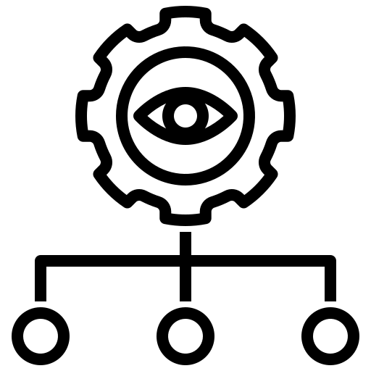
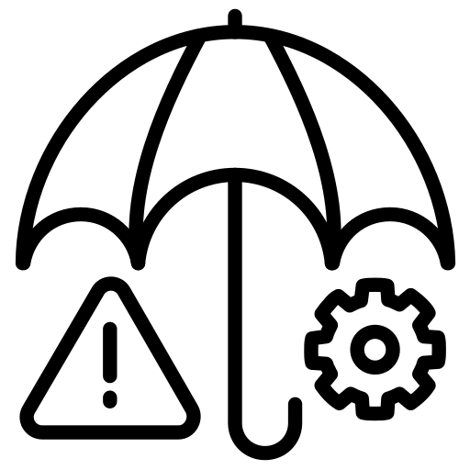

Executive Summary
In today's rapidly evolving business environment, project managers are increasingly turning to Hybrid Project Management—a fusion of predictive Waterfall methodologies with the adaptive principles of Agile. This approach offers a balanced solution, allowing organizations to maintain structure while remaining flexible in the face of changing requirements.
A hybrid approach can help meet the organizational or regulatory requirements for projects in areas such as planning, documentation, or risk management. At the same time, the project remains open to feedback in its day-to-day work and can quickly respond to changes in requirements or assumptions. By leveraging tools, techniques, roles, and practices from both methodologies, organizations can optimize project outcomes and adapt to evolving needs.
Throughout this white paper, we explore Hybrid Project Management's key features, emphasizing its ability to adapt to complexities and uncertainties, particularly in the financial industry. For instance, when implementing new regulatory requirements or developing online banking platforms, Hybrid Project Management allows for structured planning (akin to Waterfall) while accommodating evolving user needs and technological advancements (like Agile).
Our aim is to provide you with a comprehensive understanding of Hybrid Project Management benefits and challenges. We delve into specific elements crucial for success, including organizational maturity, continuous collaboration, and the importance of leveraging project management tools for managing tasks, tracking resources, and monitoring progress.
Join us as we uncover strategies and best practices for implementing Hybrid Project Management, empowering you to navigate the intricacies of project delivery with confidence and agility. Partner with FiSer Consulting to drive your institution forward with the most suitable project management methodology, tailored to the specific needs of the financial industry.
At FiSer Consulting, we operate at the heart of the change. We know what it takes to deliver programmes with challenging timelines, complex governance structures or complex integration challenges, and therefore, we are your assurance for delivery

Slide 3
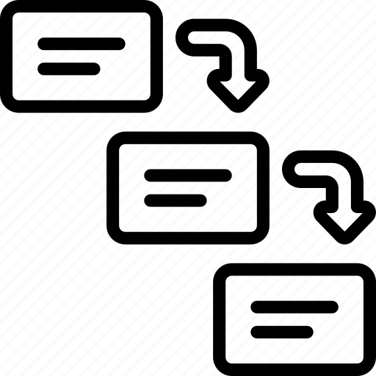


Hybrid project management: combining elements from two methodologies
Why has hybrid project management emerged?
As project needs evolve across industries, traditional methodologies alone are no longer sufficient. The rise of agile methodologies, particularly in software development, has influenced the adoption of hybrid approaches: one-size-fits-all simply does not work for every project.
The blending of waterfall and agile methodologies
Predictive (Waterfall)
Hybrid
Adaptive (Agile)
Hybrid project management is a pragmatic response to the need for flexibility and adaptability in managing projects. It acknowledges that projects can have elements of both predictability and uncertainty, and it aims to strike a balance between structure and agility.
What does it mean for project managers?
Organizations are recognizing the value of hybrid approaches, reflecting the need for project managers to remain versatile and adept at integrating diverse methodologies to tailor their practices to the specific demands of a project
Project managers need to grasp the strengths of both predictive and adaptive methodologies to apply them effectively to their project or project phase
This shift requires project managers to embrace a flexible leadership style, ensuring delivery of requirements, prioritizing team needs and fostering continuous improvement

Slide 4

Waterfall & Agile: main characteristics of each project management approach
Historically, project management followed a structured, sequential series of steps. However, with the rise of software development in recent decades, the need for more adaptive methods led to the adoption of Agile. Yet, the increasing complexity of projects has been demanding project managers to tailor their project management practices to the specific demands of a project. As a result, it is essential for you to understand the main elements of both Waterfall and Agile approaches:
Predictive or Waterfall
Adaptive or Agile
Sequential and linear process, where each phase of the project (e.g., planning, execution, monitoring, and closure) is completed before moving on to the next one.
Usually, it adopts a formal reporting approach with stakeholders throughout the project lifecycle, involving extensive documentation.
It is ideal for projects with well-defined requirements and a stable environment, such as implementing a new regulatory reporting system for a financial institution to comply with updated regulatory requirements.
Challenges and limitations associated with the traditional approach include high cost of change, and complex planning and progress tracking, making it a risky methodology for projects where there are numerous unknowns.
Overall, the waterfall approach is particularly beneficial for projects with clearly defined and predictable outcomes.
Iterative and incremental approach that focuses on delivering small, incremental portions of the project in short cycles called sprints.
Commonly adopts a proactive risk management approach, emphasizing on continuous collaboration with stakeholders.
It is well-suited for projects with rapidly changing requirements and uncertainties, such as software development for a financial services platform that requires integrating multiple technologies and adapting to changing market conditions.
Challenges and limitations include complex project contracts, difficulty to estimate the project dimension at an early stage, and significant experience required from the project team.
Ultimately, it is helpful to apply Agile methodology in complex projects when the end goal is unclear or when there is no clear path to achieving it.
By understanding the strengths and limitations of each method, organizations can tailor their project management approach to best suit the specific requirements and uncertainties of their projects

Slide 5



Hybrid project management improves project performance by enabling adjustments throughout the cycle
Hybrid project management offers tailored flexibility by allowing customization to suit each project's unique requirements, integrating predictive phased structures for clear milestones and embracing iterative progress like Agile methodologies, enabling ongoing adjustments throughout the project lifecycle.
Among other benefits, hybrid project management allows you to:
Minimize
risks
Hybrid project management minimizes disruptions by effectively identifying and managing risks throughout the project lifecycle. By proactively addressing potential challenges throughout the project lifecycle, teams can maintain alignment with Agile principles, ensuring timely delivery of the project or program.
Have better resource management
Hybrid project management combines structured resource allocation from predictive methodologies with Agile's flexibility for dynamic reallocation. With an Agile approach, the project is broken down into smaller, manageable tasks, allowing for more precise resource estimation. Regular assessment of resources assures timely identification of resource gaps and needs.
Deliver higher efficiency
Hybrid approaches speed up the delivery of a project by integrating Agile practices while also upholding control over project scope and quality. This approach allows you to reach goals faster and achieve better results while minimizing expenses.

Slide 6

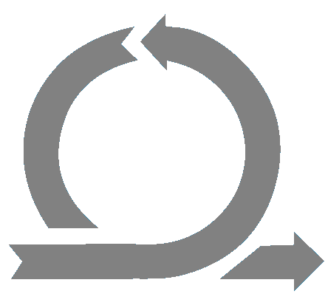
Implementing a regulatory driven program using hybrid project management
Implementing a regulatory driven compliance program at a bank
Imagine that you are asked to implement a regulatory driven compliance program. Legislation is changing and the big-bang Go Live is set in 2 years from now: multiple entities in a multinational organization must comply with new rules and regulations.
You might adopt a traditional Waterfall approach for the initial assessment and documentation phases to ensure thorough compliance analysis. Meanwhile, you can leverage Agile methodologies for the implementation and testing phases, allowing for quick adjustments based on feedback and changing regulatory guidelines.
REQUIREMENTS
DESIGN
IMPLEMENT
RELEASE
MAINTENANCE
Waterfall
Agile
Business as usual

Slide 7


The use of different approaches can cause confusion among your stakeholders
These are the things to keep in mind while practicing hybrid project management
Although the advantages of hybrid project management outweigh the challenges, there are things that require attention when deciding if hybrid is the appropriate approach for your project. Keep in mind that:
Tracking deliverables might be difficult due to the use of multiple systems
There is a need for continuous coordination between teams to ensure a clear alignment or dependency across teams
The management level must have a clear understanding on how the hybrid approach works to ensure a successful implementation
These challenges highlight the need for better alignment of planned activities, improved awareness of the dependencies and a structured approach, as well as trainings and support to organize and compose a hybrid project set up.

Slide 8




Therefore, we recommend project managers to incorporate four key elements to implement hybrid approach successfully
With the challenges of implementing the hybrid approach in mind, we recommend project managers investigate four key elements to ensure success of the project. Meanwhile, project managers should adopt a flexible leadership style during the implementation. By considering the needs of the project’s team and helping them develop and perform to the best of their abilities, the project manager can cultivate a culture of trust, collaboration, and empowerment, which is crucial in driving any changes in an organization.
Continuous Monitoring and Feedback Venus
Clear Communication and Collaboration
Tailored Training and Support
Regular monitoring of project progress and team performance
Frequent feedback loops to address issues and make improvements
Strategies for team building and cohesion
Importance of effective communication in hybrid teams
Utilizing collaboration tools and platforms
Nurturing trust and collaboration in hybrid team environments
Training and supporting team members as well as the managerial level to understand hybrid project management in practices
Establishing guidelines and policies for hybrid work arrangements
Flexibility and Adaptability
Emphasizing the need to adapt to changing circumstances
Encouraging a flexible mindset in hybrid project teams
Notes:
Look at content wise, make more informative (not so shallow) → what do you need to make a success of hybrid project management
Is it possible to define high-level project phases and their goals?
Can you choose the way you work freely?
Do you have people who are well-experienced in Agile?
Can you agree with the project requestor that only a high-level plan will be present and detailed work will be not included in the contract?
Is the rest of project team experienced with Agile ways of working? I.e. Prioritizing backlog, planning short sprints, estimating in story points, retrospecting?
If you have ticked all 5 with a YES then you have the potential to run your projects the hybrid way and enjoy the benefits of hybrid project management. If not, then you should perform necessary actions to make a majority of those points a YES, before starting your first project. Having knowledge is not enough especially when combining techniques/methodologies. You need well-seasoned people who will steer the process and project both on bright and dark days. From our experience, the hardest part could be to convince project stakeholders to do it differently, especially if stakeholders are external parties. Aligning and proposing the benefits can be a project in itself!
Skills needed for hybrid project management
Not every project manager has the skills to use this approach in their projects, and project managers seeking to reap the benefits of such an approach may want to consider upskilling to ensure they can successfully balance a hybrid project. Some of the skills needed for hybrid project management include:
Balanced knowledge of each method
Good stakeholder communication
Good team management skills
The ability to produce hybrid project management reports that demonstrate ROI properly
Those project managers who have until now used Agile methods may require a refresher of traditional project management methods, while those who have never completed Agile projects may wish to take on some additional training. This way, the project manager can broaden their knowledge and apply best practice to each project they undertake.

Slide 9


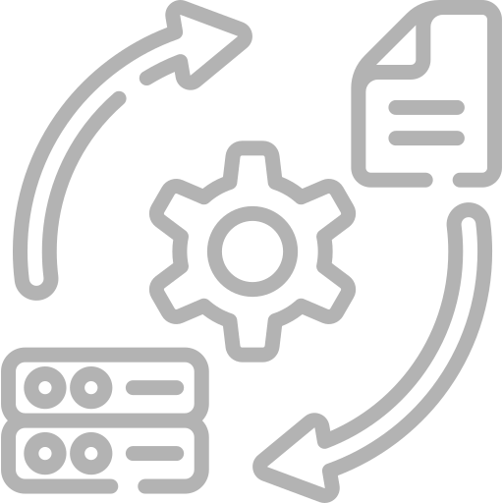
Key features to look for in hybrid project management tools
In today's hybrid project management environment, equipping yourself with the right tools facilitates success. The current environment also demands additional tools for remote collaboration, including video conferencing and document management platforms.
With an extensive offering of options available in the market, project managers must carefully assess whether a tool or technology meets the specific requirements of each project phase before selecting it to support effective project leadership.
Define and Manage
Monitor and Report
For effective project initiation and planning, the chosen tool must encompass features to define and manage key project aspects such as scope, schedule, budget, and quality
To keep projects on track, the tool should facilitate easy monitoring and reporting of project status, milestones, and deliverables, providing stakeholders with real-time insights and adequate granularity
Assign and track
Incorporate Agile practices
To ensure smooth project execution,
the tool should enable seamless assignment and tracking of roles, responsibilities, and resources within the project management framework
To adapt to changing project needs and promote agility, an effective tool for hybrid project management should incorporate elements from Agile, including user stories, sprints, backlogs, and feedback loops

Slide 10





FiSer Consulting makes a project governance tailored to your organization and ensure a smooth transition
FiSer Consulting is a young, niche and independent consulting firm with an exclusive focus on international business transformation within Financial Services. Our people have a broad range of project management experience with all large Dutch banks, multiple international insurers and smaller clients. With FiSer’s expertise, we will tailor a project governance that fits your project needs and address the pain points that your organisation may encounter when implementing the new project approach.
Target Landscape
Prepare your vision on project management implementation (Waterfall, Agile, or Hybrid).
Develop a strategic roadmap
Create a roadmap including necessary steps, timelines, and resources required.
Always Expert Advice
Continually consult with advisors to navigate the complexities and ensure a successful delivery.
Gap Analysis
Conduct a thorough gap analysis to identify areas where your project governance needs to enhance.
Engage Stakeholders
Engage all stakeholders to adapt to the tailored project management approach.

Slide 11


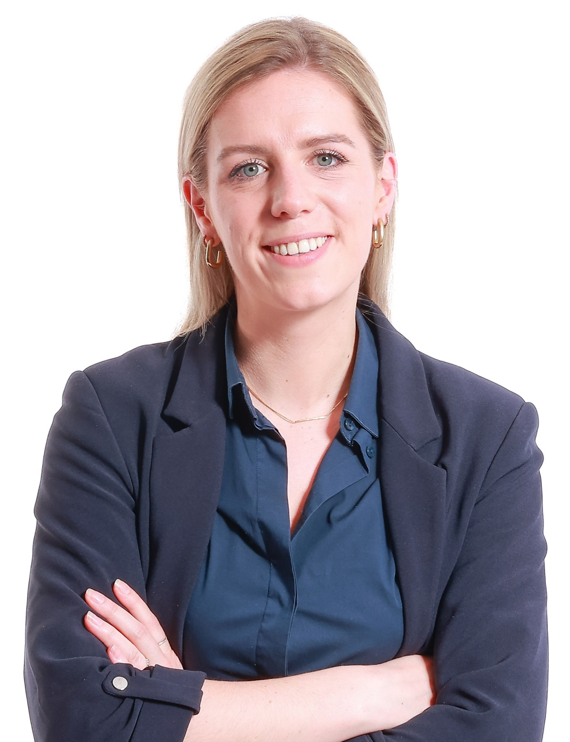

Contact our colleagues at FiSer Consulting for further assistance
FiSer has a proven track record in helping clients navigate complex implementations. Hence, we offer tailored services to meet the needs of your business, ensuring a smooth and efficient path to manage projects in a hybrid way.
Mischa Wesdorp – Managing Partner
Mischa brings over 20 years of experience in the Global Financial Services Industry, managing large, complex and multi-disciplinary programs for Dutch based banks and insurance companies.
Pei Hsuan Lo – Senior Consultant
Pei-Hsuan has eight years of experience on banking, working strategic transformation programmes across Risk Management and Retail Banking.
m.wesdorp@fiser.consulting
pei-hsuan.lo@fiser.consulting
Roos Meijer – Consultant
Roos is a consultant in the Insurance and Pensions practice at FiSer Consulting. Currently, she is working as a PMO on a global regulatory program within the payments industry.
Camila Herrera – Senior Consultant
Camila is a banking professional with a background in Asset & Liability Management, Funding Strategy, and Debt Capital Markets, including sustainability-related transactions.
r.meijer@fiser.consulting
c.herrera@fiser.consulting
FiSer Consulting Website
info@fiser.consulting
Follow us on LinkedIn!
11

