Slide 1

EU AI Act:
Compliance and Business
Opportunities for the Financial Sector
July, 2023

Slide 2

The power of AI: the EU AI Act and its impact on financial institutions
Artificial Intelligence (AI) has gained immense prominence in recent years as it has been transforming industries worldwide.
AI is a fast-evolving family of technologies that can bring a wide array of economic and societal benefits by improving prediction, optimizing operations and resource allocation, and personalizing service delivery through smart algorithms. The use of artificial intelligence can support socially and environmentally beneficial outcomes and provide key competitive advantages to companies and the European economy, especially in high impact sectors such as finance.
The European Union recognizes the potential of AI while acknowledging the need for responsible regulation. In 2017, the European Commission (EC) urged action on emerging technological trends, including AI. In February 2020, the EC released a White Paper outlining policy options for AI. In October 2020, resolutions on AI ethics, liability, and copyright were adopted – but these are not binding. On 21 April 2021, the EC has released the proposed Regulation on Artificial Intelligence (the EU AI Act). The Act will harness the challenges and risks associated with AI, while enhancing the opportunities AI can bring.
Similar to the General Data Protection Regulation (GDPR), the EU Act has the potential to become a global standard that dictates the extent to which AI can be used. As tech-driven innovation is fundamentally reshaping the financial industry, the EU AI Act will have a significant impact on financial institutions, requiring them to adapt strategies and practices to align with new legal and ethical standards.
By understanding the implications and requirements outlined in this document, financial institutions can proactively adapt their AI strategies, mitigate risks, and capitalize on the opportunities presented by the evolving AI landscape.
Notes:
Roos

Slide 3


Table of Content
2 | Introduction | 11 | Prohibited AI Practices
3 | Table of content | 12 | High-Risk AI Systems
4 | Integral role of AI | 13 | Transparency Obligations
5 | A brief history | 14 | Measures in Support
6 | Drivers of AI integration | 15 | Governance & Implementation
7 | Current barriers | 16 | Strategic action plan
8 | Legislative landscape | 17 | Timeline - Roadmap EU AI Act
9 | Objectives and scope of the AI Act | 18 | Conclusion
10 | The core elements of the EU AI Act | 19 | Get in touch with FiSer Consulting
3

Slide 4
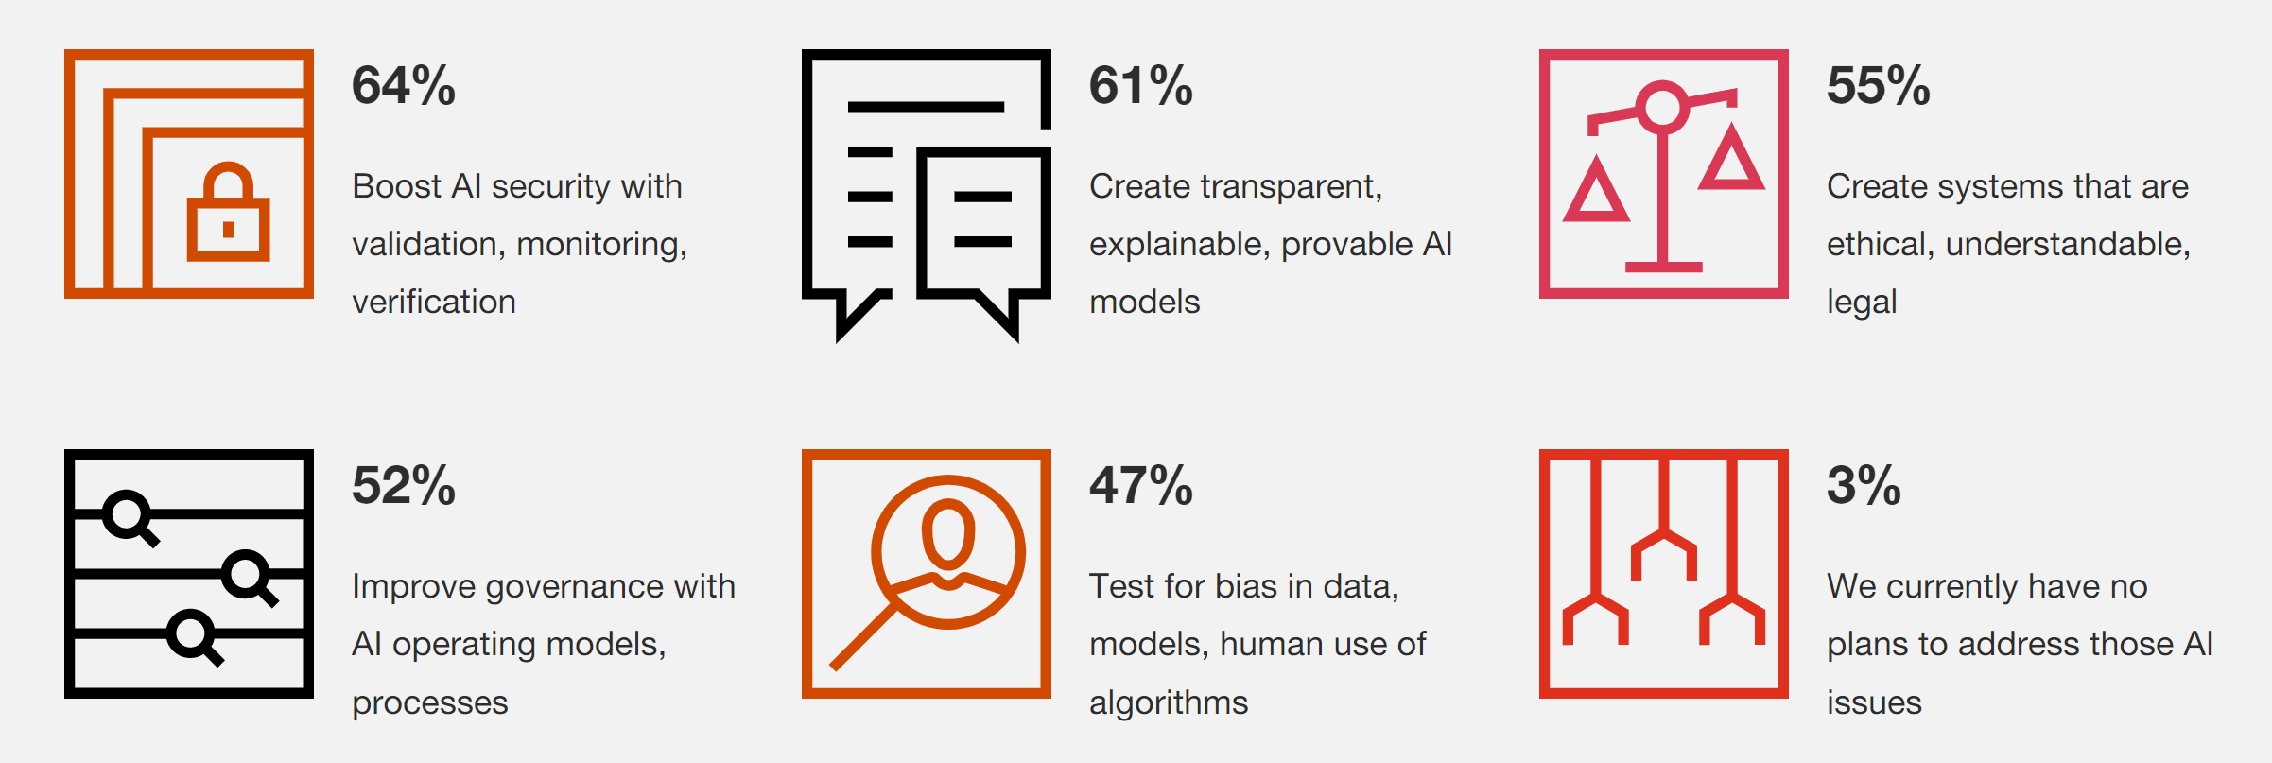
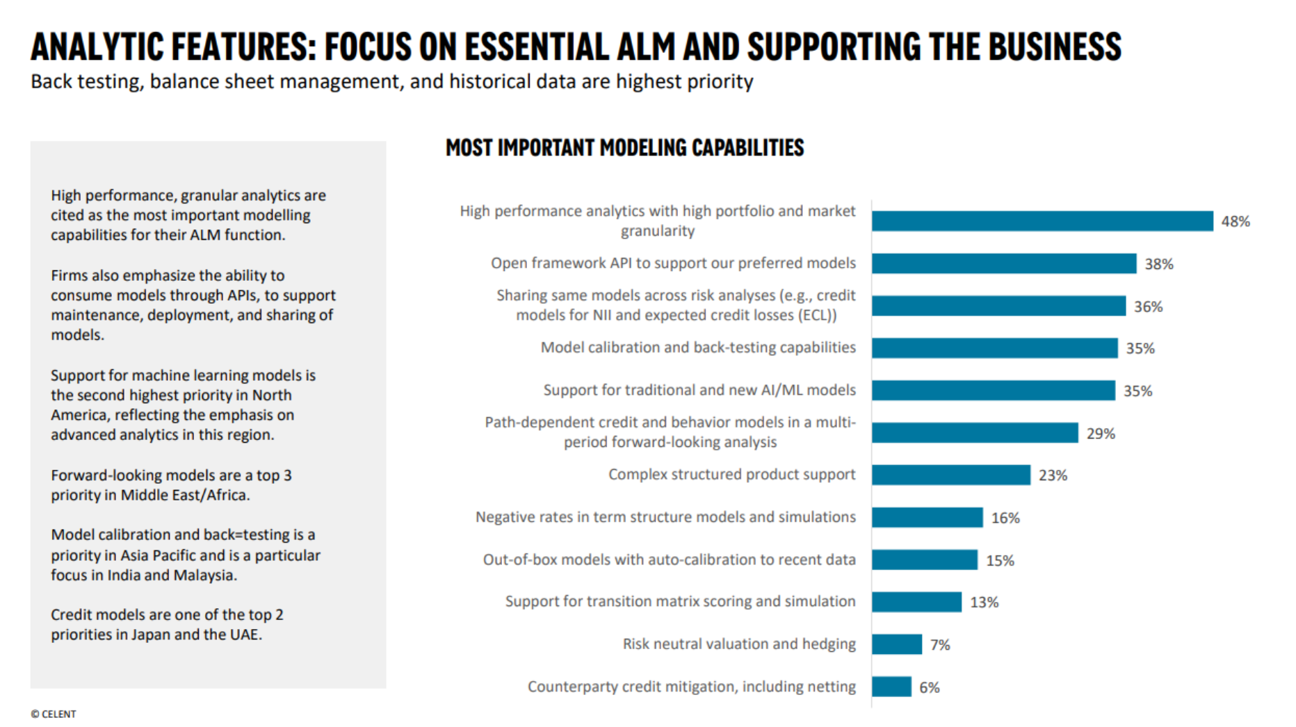
Accelerating financial evolution: the integral role of AI in global and European markets
77% of financial institutions have implemented or plan to implement AI to improve client communication.
AI has the potential to increase financial services revenues by 34% and economic growth by 26%.
41% of financial services executives believe AI chatbots will have the largest impact on their industry by 2025.
AI-driven customized financial advice is expected to grow at a CAGR of 12.6% between 2021 and 2026.
By 2022, AI technologies in the financial industry could reduce the need for lower-skilled jobs by over 50%.
AI applications are expected to represent 25% of global investment in non-human-underwritten loans by 2025.
60% of financial services firms believe that using AI for customer interactions can enable personalized customer experiences.
66% of financial services firms see AI as a priority for process automation and optimizing back-end operations.
83% of financial services executives believe that AI will boost productivity and enhance decision-making capabilities.
€9.5 bn
estimated market value of AI in finance in 2021, with growth expected to reach 16.5% by 2030
€33 bn
projected AI spending in Europe for 2023, making up 20% of the global
AI market
29.6%
expected compound annual growth rate (CAGR) of AI spending in Europe between 2021 and 2026
25%
of global investment in non-human underwritten loans is expected to be generated by AI until 2025
34%
potential increase in financial services
revenues due to
solutions powered by AI
83%
of financial services executives believe that AI will boost productivity and decision-making
41%
of banking executives believe AI chatbots will have the largest impact on their industry by 2025
77%
of financial institutions have implemented or plan to implement AI solutions and applications
$7 billion was the value of the European AI market in 2019, with forecasts predicting a tripling to over $21 billion by 2023​¹​.
$33.2 billion is the projected AI spending in Europe for 2023, making up 20% of the global AI market, according to another source​²​.
29.6% is the expected compound annual growth rate (CAGR) of AI spending in Europe between 2021 and 2026​²​.
Two-thirds of total spending in 2023 is estimated to be on software within the AI market​²​.
Over half (55.5%) of the total European AI market spending in 2023 is expected to come from the banking, retail, and manufacturing sectors, followed by professional services​²​.
€6,000 to €7,000 is the estimated cost of AI Act compliance for vendors per system, and €5,000 to €8,000 per annum for users, according to the European Commission​³​.
Up to 6% of a company's global annual revenue could be the penalty for non-compliance with the AI Act, depending on the severity of the breach​³​.
$9.45 billion was the estimated market value of AI in finance in 2021, with growth expected to reach 16.5% by 2030​⁴​.
AI Use In Financial Services Statistics And Trends in 2023 • GITNUX
Notes:
Gabi
See what we should do with sources → should we cite?

Slide 5


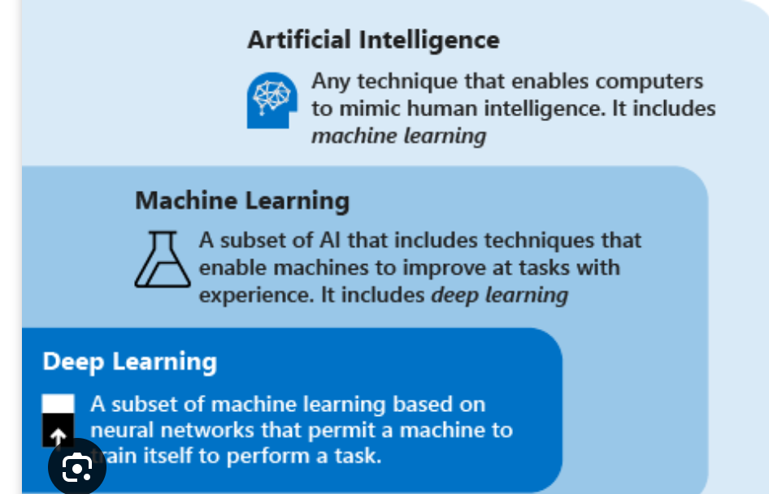
The history of AI is marked by periods of acceleration and stagnation
1950
1974 – 1980
1987 - 1993
2000 - now
The term Artificial Intelligence was coined by John McCarthy (Stanford University)
The history of AI is marked by periods of stagnation (‘AI Winters’) and acceleration. Both winters are triggered by over-inflated expectations and the withdrawal of funding.
Another winter due to the failure of AI systems. Technology was hard to build and run, making it overly expensive which made them fall out of flavor.
Why would things be different this time? Is it AI’s big moment in the sun?
Popularity
Artificial Intelligence Machine Learning Deep Learning
The developments on AI are characterized by periods of stagnation and acceleration
Notes:
Roos
Book: the executive guide to artificial intelligence – how to identify and implement applications for AI in your organization (Andrew Burgess)
https://sitn.hms.harvard.edu/flash/2017/history-artificial-intelligence/
The history goes back over 50 years and includes periods of stagnation (referred to as ‘AI Winters’) as well as acceleration. It is worth providing a short history of AI so that the developments of today, which really is AI’s big moment in the sun, can be put into context.
Term was coined by John McCarthy, professor from Stanford University -> summer of 1959
AI Winter 1: 1974 – 1980
Triggered by over-inflated expectations and the withdrawal of funding
Three events:
a 1973 report by Sir James Lighthill for the UK Government which criticised the ‘grandiose objectives’ of the AI community and its failure to get anywhere near reaching those objectives;
and in the United States where the Mansfield Amendment required the Advanced Research Projects Agency (ARPA, now known as DARPA) to only fund projects with clear missions and objectives, particularly relating to defence, which AI at the time couldn’t satisfy;
and the perceived failure of a key project for ARPA that would have allowed fighter pilots to talk to their planes. These events meant that much of the funding was withdrawn and AI became unfashionable.
AI Winter 2: 1987 – 1993
Triggered by over-inflated expectations and the withdrawal of funding as well
Mainly due to the failure of ‘expert systems’ to meet their over-inflated expectations in 1985, when billions of dollars were being spent by corporations on the technology. They were difficult to build and run, making them overly expensive which made them fall out of flavour.
SO WHY NOW?
Is the current boom in AI just another case of over-inflated expectations? What is driving the current AI wave? Why this time could be different for AI:
Role of big data → sheer volume of data that is now available
Role of cheap storage → the data need to be stored somewhere
Role of faster processors → processing all the big data sets
Role of ubiquitous connectivity → internet, 4G, 5G, smartphones, etc.
Cloud AI → where all four of these drivers come together
Insurance 2030—The impact of AI on the future of insurance | McKinsey

Slide 6




Unleashing AI’s potential in a tech-driven era: why this time is different
The Role of Big Data
The Role of Cheap Storage
The first driver of the AI explosion is the sheer volume of data that is now available. To train an AI system, organizations need enormous amounts of data.
This data must be stored somewhere. As the costs and the size of machines to store the data are decreasing, the interest in AI increases.
The Role of Faster Processors
The Role of Connectivity
Faster processor speed is important, since training AI systems takes time. These processors allow for more complex problems to be solved.
Global networks have now become big enough to allow large amounts of data to be distributed (5G).
Notes:
ROOS
Is the current boom in AI just another case of over-inflated expectations? What is driving the current AI wave? Why this time could be different for AI:
Role of big data → sheer volume of data that is now available
Role of cheap storage → the data need to be stored somewhere
Role of faster processors → processing all the big data sets
Role of ubiquitous connectivity → internet, 4G, 5G, smartphones, etc.
Cloud AI → where all four of these drivers come together

Slide 7




Breaking down barriers to AI adoption with the introduction of the EU AI Act
Expectations
There is an excessive amount of discussion and speculation surrounding the potential of AI, undermining its real capabilities. Machine learning algorithms can do a lot but are still driven by statistics and people; human like robots and self-driving cars are still far away – if they ever see the day of light at all.
Fear
Fear for the unknown is a completely natural reaction, and one of the oldest and strongest emotion of mankind. A lot is still unknown when it comes to the use of AI and its implications. The fear of losing control and AI fundamentally changing the way we work is fueled by the hype.
Ignorance
The first two feed the third barrier: if people do not understand what it is, how can we expect any value to come from these solutions? It is a complex subject, where knowledge is needed in both the area of algorithms and on the interface of technology and business.
Regulations
Much of what is performed by AI systems is not visible for humans. The reason behind certain outcomes can remain unclear, posing difficulties for regulators who require transparent decision-making processes. AI systems need explainability and transparency on decision-making, data use and ethical issues.
The European AI Act will try to tackle most of these barriers.
Notes:
ROOS → design check → regulations most important
Read: barriers to AI → executive guide to artificial intelligence (not so much challenges)
The over-inflation of expectations
The fear of what changes AI might bring (in the way people work)
Ignorance (no understanding of what it is)
Regulation (AND THIS WILL BE TACKLES WITH AI ACT)
“Much of the computational work that is done by an AI system is hidden from the developer or user—there is (generally) no audit trail that details how it came to a certain decision. If I fed a complex credit decisioning AI system with lots of loan applications as training data and told it which had been approved and which hadn’t, it could then make a recommendation of whether to approve or reject a new loan. But no one would really know why, and that causes a problem for regulators who need to see that decision process written down. There are some approaches which can mitigate this, but the opaqueness of AI can be a real challenge to its usefulness.”

Slide 8
The EU AI Act as a complementary force to existing legislation
This is a legally binding document that sets out the fundamental rights (civil, political, economic, social) protected in the EU. All states must comply when implementing services.
EU Charter of Fundamental Rights
Complements the GDPR by focusing specifically on the protection of privacy and confidentiality in electronic communications such as cookies, direct marketing, and the processing of metadata.
A comprehensive data protection regulation that applies to all EU member states. It establishes rules for the collection, processing, and storage of personal data, including provisions regarding consent, data subjects' rights, and data breaches.
ePrivacy Directive
General Data Protection Regulation (GDPR)
European AI Act
The Artificial Intelligence Act will be consistent with and complement on current legislation. The aim is to prevent duplication and minimize burdens.
The LED sets out specific requirements and safeguards for the processing of personal data in the law enforcement context, ensuring that individuals' rights and freedoms are protected
Law Enforcement Directive (LED)
New Legislative Framework (NLF)
The NFL is designed to streamline the regulatory framework for product sectors (electronic goods and machinery mainly) to adapt to technological advancements and market developments.
Notes:
ROOS → MECE??? → Lorin + Jeroen
Legislation will be consistent with / complement on:
EU Charter of the Fundamental Rights
Union legislation on data protection, consumer protection, non-discrimination and gender-equality
General Data Protection Regulation
Law Enforcement Directive
New Legislative Framework (NLF, for machinery, medical devices etc → safety)
To prevent duplication and minimise burdens
SPECIFICALLY FOR FINANCIAL SERVICES:
“As regards AI systems provided or used by regulated credit institutions, the authorities responsible for the supervision of the Union’s financial services legislation should be designated as competent authorities for supervising the requirements in this proposal to ensure a coherent enforcement of the obligations under this proposal and the Union’s financial services legislation where AI systems are to some extent implicitly regulated in relation to the internal governance system of credit institutions.”

Slide 9


Promoting responsible AI use, ensuring legal certainty and fostering market trustworthiness
The Act will ensure a solid risk methodology to define ‘high-risk’ AI systems that pose significant risk to the health and safety or fundamental rights of persons.
The proposal for the European AI Act sets out policy options on how to achieve the twin
objective of promoting the uptake of AI and of addressing the risks associated with certain
uses of such technology
The Act will mitigate risks of safety, security and fundamental rights through a regulatory framework (ensuring transparency, accountability and human oversight.
The proposed rules will be enforced through a governance system at member state level, building on existing structure and cooperations mechanisms at EU level, with the establishment of an EU AI Board. This will be applicable for any public or private entity that uses or makes AI systems.
Source: The Artificial Intelligence Act – European Commission (2021)
Notes:
ROOS → Check title
Summary of the act: https://www.ceps.eu/wp-content/uploads/2021/04/AI-Presentation-CEPS-Webinar-L.-Sioli-23.4.21.pdf?
objective:
Promoting te uptake of AI
Addressing the risks associated with certain uses of technology
Specifically:
ensure that AI systems placed on the Union market and used are safe and respect existing law on fundamental rights and Union values;
ensure legal certainty to facilitate investment and innovation in AI;
enhance governance and effective enforcement of existing law on fundamental rights and safety requirements applicable to AI systems;
facilitate the development of a single market for lawful, safe and trustworthy AI applications and prevent market fragmentation.
Challenges that it solves:
Solid risk methodology to define ‘high-risk’ AI systems that pose significant risk to the health and safety or fundamental rights of persons
Mitigate risks of safety, security and fundamental rights through regulatory framework (transparency, accountability and human oversight are important)
Scope
Proposed rules will be enforced through a goverannce system at Member State level, building on existing structures + cooperation mechanism at Union Level with the establishment of a EU AI board.
Any private or public entity that uses or makes AI systems
Relevant stakeholders
Developers and providers of AI systems
AI system users
Regulatory authorities
Impact
Banks: for the use of fraud detection, risk assessment, algorithmic trading, customer service. The act will require financial institutions to ensure compliance with regulatory requirements such as risk management, transparency, and human oversight.
HIGH-RISK: financial institutrions that use AI systems that are will be labelled high-risk (such as loan granting or credit scoring) will have to adhere to additional obligations such as conformity assessments, data quality and traceability, and record-keeping
Transparency + explainability
Data quality + bias
Penalties + fines
Objectives
Challenges that it solves
Scope:
Title I defines the subject matter of the regulation and the scope of application of the new rules that cover the placing on the market, putting into service and use of AI systems. It also sets out the definitions used throughout the instrument. The definition of AI system in the legal framework aims to be as technology neutral and future proof as possible, taking into account the fast technological and market developments related to AI. In order to provide the needed legal certainty, Title I is complemented by Annex I, which contains a detailed list of approaches and techniques for the development of AI to be adapted by the Commission in line with new technological developments. Key participants across the AI value chain are also clearly defined such as providers and users of AI systems that cover both public and private operators to ensure a level playing field.
Relevant stakeholders
Impact → separate slide?
etc

Slide 10





The core elements of the EU AI Act
Prohibited AI Practices
High-Risk AI Systems
Transparency Obligations
Measures in Support
Governance & Implementation
Restricts AI processes that exploit people's weaknesses, manipulate them, infringe on basic rights, and limits real-time remote biometric recognition systems usage according to danger levels, aligning with Union principles and ethos, which ensures a safe, respectful interaction between humans and AI, preserving individual choice and autonomy
Creates regulations for high-stakes AI systems, guaranteeing adherence to obligatory prerequisites and undergoing preemptive conformity evaluations based on their projected purpose, not merely their functionality, which is implemented to protect the health, safety, and essential rights of individuals within the European marketplace
Focuses on AI systems with specific risks of manipulation, imposing transparency obligations when the systems interact with humans, detect emotions or biometric associations, or generate/manipulate content, ensuring individuals are informed when interacting with AI systems and enabling them to inform choices or disengage from situations
Strives to construct an adaptable, innovative legal structure for AI through encouraging regulatory testing grounds, provision of a governance system, oversight, liability rules, and lowering of regulatory pressures on SMEs and start-ups, enhancing their capacities to contribute positively in the AI field
Establishes a governance framework, enables effective tracking via an EU-wide database, and applies post-market responsibilities to ensure proper execution and conformity with rules using existing authorities and resources. This ensures a consistent and well-coordinated approach towards AI regulation across the European Union
SCOPE AND DEFINITIONS (TITLE I)
PROHIBITED ARTIFICIAL INTELLIGENCE PRACTICES (TITLE II)
HIGH-RISK AI SYSTEMS (TITLE III)
TRANSPARENCY OBLIGATIONS FOR CERTAIN AI SYSTEMS (TITLE IV)
MEASURES IN SUPPORT OF INNOVATION (TITLE V)
GOVERNANCE AND IMPLEMENTATION (TITLES VI, VII AND VII)
CODES OF CONDUCT (TITLE IX)
FINAL PROVISIONS (TITLES X, XI AND XII)
Notes:
Gabor
Title I = Scope and definitions
…
Title IX = Codes of conducts
Title X, XI, XII = Final provisions

Slide 11
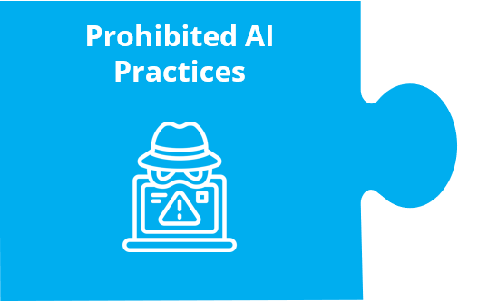



Prohibited AI Practices: Four elements addressing specific AI practices that are deemed harmful
Subliminal Manipulation
Prohibits the use of AI systems that deploy subliminal techniques beyond a person's consciousness to materially distort behavior, causing physical or psychological harm
Unjust Social Scoring
Prohibits the use of AI systems by public authorities to evaluate or classify individuals based on social behavior or personal characteristics, leading to unjustified detrimental treatment or discrimination
Unacceptable
Risk
AI Systems
Exploitation of
Vulnerable Groups
Prohibits the use of AI systems that exploit the vulnerabilities of specific groups based on age, physical or mental disability, to materially distort behavior, causing physical or psychological harm
Remote Biometric
Identification
Restricts real-time use of remote biometric identification systems in public spaces for law enforcement, allowing it only when strictly necessary for specific objectives
Notes:
Gabor → put element icon + title from slide 10 in the seperate element slide

Slide 12
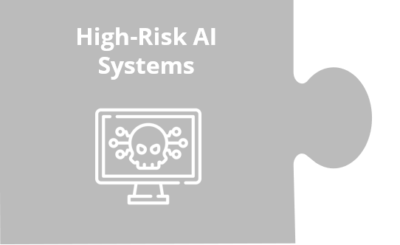

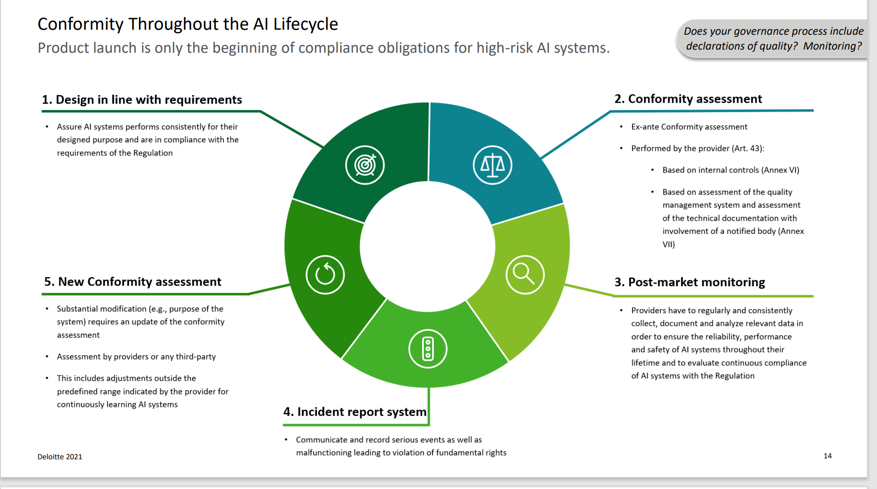



High-Risk AI Systems: Ensuring Responsible Deployment of High-Risk AI Systems
Ensuring Responsible Deployment and Mitigating Risks of High-Risk AI Systems
Classification
AI system is considered high-risk if it is intended to be used as a safety component of a product covered by Union harmonization legislation and requires third-party conformity assessment
Legal Requirements for the systems
Implementing data management to safeguard privacy, security, and ethical use of data, maintaining documentation and traceability, clear communication to users about capabilities, limitations, and potential risks, incorporating mechanisms for human oversight to ensure control and accountability in critical tasks, and developing systems with a focus on reliability, accuracy, and security to minimize risks
Obligations for Stakeholders
Providers are responsible for designing, developing, and deploying AI systems with appropriate safeguards and compliance measures, while users and other stakeholders share proportionate obligations, promoting shared responsibility and accountability
Conformity and Notified Bodies
Involves independent third-party notified bodies evaluating the compliance of high-risk AI systems with legal requirements and regulatory standards, tailoring assessments to the specific design, functionality, and adherence of each
Compliance and Enforcement
Includes measures aligned with sectorial legislation for safety components and establishing a new system for stand-alone AI systems, ensuring ongoing adherence, addressing non-compliance promptly, and mitigating risks through assessments, checks, and post-market monitoring
CHAPTER 1 - CLASSIFICATION OF AI SYSTEMS AS HIGH-RISK
  Article 6 Classification rules for high-risk AI systems
  Article 7 Amendments to Annex III
CHAPTER 2 - REQUIREMENTS FOR HIGH-RISK AI SYSTEMS
  Article 8 Compliance with the requirements
  Article 9 Risk management system
  Article 10 Data and data governance
  Article 11 Technical documentation
  Article 12 Record-keeping
  Article 13 Transparency and provision of information to users
  Article 14 Human oversight
  Article 15 Accuracy, robustness and cybersecurity
CHAPTER 3 - OBLIGATIONS OF PROVIDERS AND USERS OF HIGH-RISK AI SYSTEMS AND OTHER PARTIES
Article 16 Obligations of providers of high-risk AI systems
Article 17 Quality management system
Article 18 Obligation to draw up technical documentation
Article 19 Conformity assessment
Obligations for Stakeholders
Classification of
High-Risk AI Systems
Legal
Requirements
Conformity and Notified Bodies:
Compliance and Enforcement
Notes:
Gabor

Slide 13
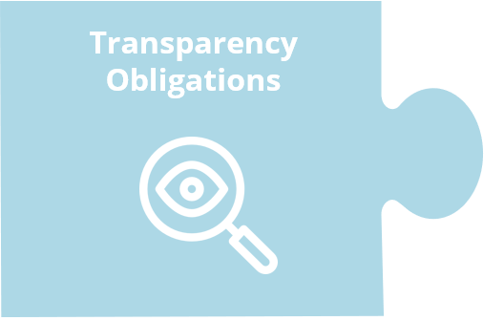




Transparency obligations for AI systems under the EU AI Act
AI System Identification
Notification for Emotion Systems
Disclosure of Deep Fake Content
Other
Requirements
Users must be informed when they are interacting with an AI system.
Users of emotion recognition or biometric categorization systems must inform individuals subjected to these systems.
Users of AI systems that generate or manipulate content must disclose that it is modified.
The requirements and obligations set out in the Act remain intact and should not be affected by the beforementioned transparency obligations.
Note: there are exceptions to these obligations. For the full context, read The EU AI Act
Notes:
Roos – change icon + title from element slide
concerns certain AI systems to take account of the specific risks of manipulation they pose. Transparency obligations will apply for systems that (i) interact with humans, (ii) are used to detect emotions or determine association with (social) categories based on biometric data, or (iii) generate or manipulate content (‘deep fakes’). When persons interact with an AI system or their emotions or characteristics are recognised through automated means, people must be informed of that circumstance. If an AI system is used to generate or manipulate image, audio or video content that appreciably resembles authentic content, there should be an obligation to disclose that the content is generated through automated means, subject to EN 15 EN exceptions for legitimate purposes (law enforcement, freedom of expression). This allows persons to make informed choices or step back from a given situation.

Slide 14




Empowering innovation with a supportive regulatory environment
Measures in Support
AI Regulatory Sandboxes
Measures for small-scale providers and users
Sandboxes will be established for developing and testing AI systems in a controlled environment.
Supervised by authorities to ensure compliance with regulations.
Risks to safety and rights should be addressed promptly.
Small-scale providers get priority access to AI sandboxes.
Special guidance and reduced fees for conformity assessment.
Encourages innovation and participation of smaller companies.
Processing data for developing AI systems
Personal data can be used in the sandboxes for developing AI systems.
There will be strict conditions for data protection and confidentiality.
Documentation and transparency requirements.
Notes:
Roos – Title
A regulatory sandbox is a tool allowing businesses to explore and experiment with new and innovative products, services or businesses under a regulator's supervision.

Slide 15
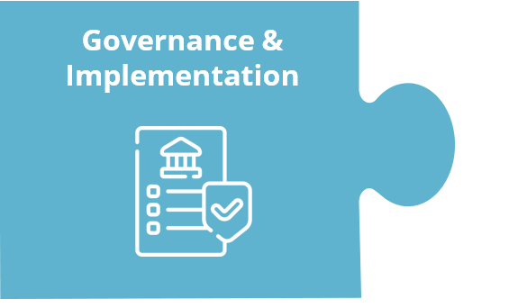



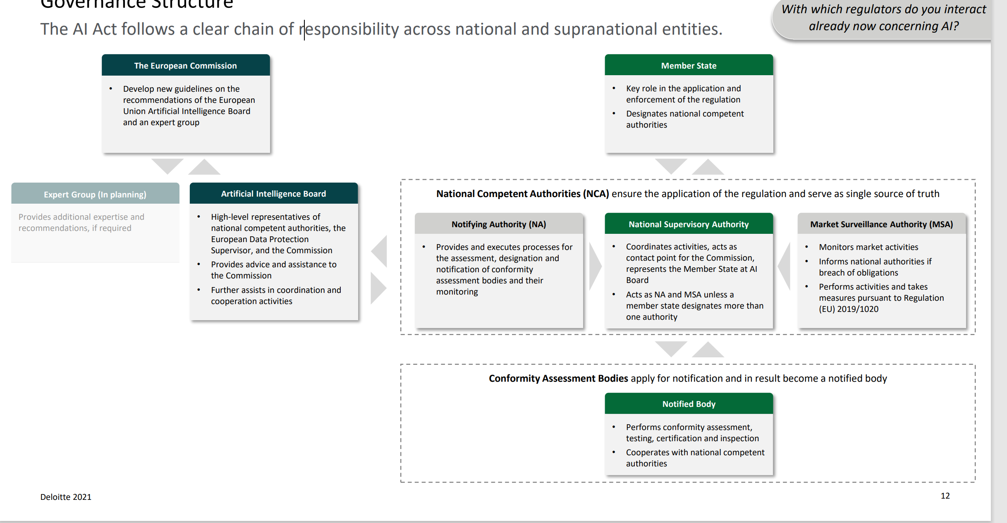
Responsible governance and enforcement mechanisms to ensure accountable use of AI
SHARING OF INFORMATION ON INCIDENTS AND MALFUNCTIONING
NATIONAL COMPETENT AUTHORITIES
EU DATABASE FOR STAND-ALONE HIGH-RISK AI SYSTEMS
POST-MARKET MONITORING
ENFORCEMENT
European Artificial Intelligence Board
The European Artificial Intelligence Board, composed of national supervisory authorities, the European Data Protection Supervisor, and other invited national authorities, provides advice and assistance to the Commission, ensuring effective cooperation, coordination, and consistent application of the regulation
European Artificial Intelligence Board
National Competent Authorities
Database for
High-Risk AI Systems
Post-Market
Monitoring
Sharing of information
Market
Surveillance
Offers guidance and coordination for national supervisors and Commission, ensuring rule consistency
Composed of national supervisors, European Supervisor, invited authorities, with rules, sub-groups, and Union collaboration
Ensures regulation application by each Member State
Assigns a national authority among competent ones, supporting coordination
Provides guidance, sets contact points, and reports resources to the Commission
Set up and maintained by the EC with the Member States
Data on registered high-risk AI systems,
Includes necessary personal data
Enhancing transparency and oversight
Providers set systems for monitoring high-risk AI performance
Active data collection and analysis from users and relevant sources
Constant evaluation of AI compliance with regulations
Report serious incidents of high-risk AI to authorities
Authorities access data, documentation, source code
Coordination among authorities for information sharing
Procedures and measures for non-compliant AI
Authorities act on non-compliance, including AI withdrawal
Coordination for regulation enforcement and responsible AI use
Notes:
Gabor

Slide 16









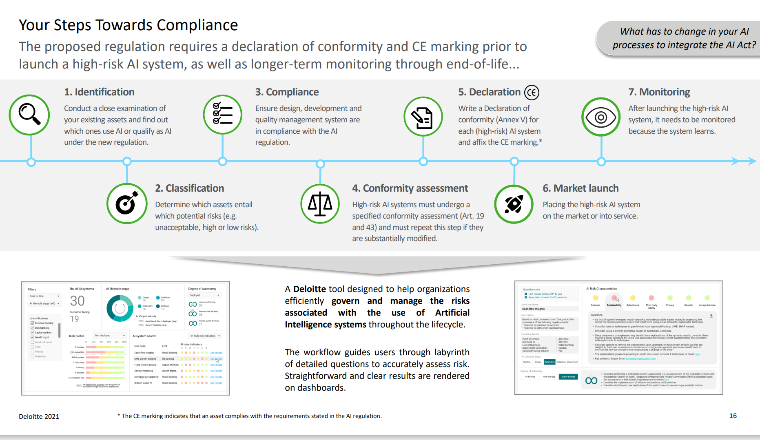
A strategic action plan to seize the AI opportunity and navigate your business towards regulatory compliance with the AI Act
Awareness Building
Become educated about AI technologies and trends, understanding their potential implications and opportunities
Strategic Planning
Become educated about AI technologies and trends, understanding their potential implications and opportunities
Data Strategy
Become educated about AI technologies and trends, understanding their potential implications and opportunities
Awareness Building
Become educated about AI technologies and trends, understanding their potential implications and opportunities
Awareness Building
Become educated about AI technologies and trends, understanding their potential implications and opportunities
Awareness Building
Become educated about AI technologies and trends, understanding their potential implications and opportunities
Awareness Building
Become educated about AI technologies and trends, understanding their potential implications and opportunities
Awareness Building
Become educated about AI technologies and trends, understanding their potential implications and opportunities
Awareness Building
Become educated about AI technologies and trends, understanding their potential implications and opportunities​
Data Strategy Execution
Construct and execute a comprehensive data strategy thta ensures data privacy, security, and ethics in AI initiatives
Tech Infrastructure
Form a stat-of the-art technology infrastructure to support and accelerate all AI activities in the suitable environment
Gap Analysis Implementation
Perform a gap analysis to identify compliance discrepancies with the AI Act's requirements and guide strategic planning
Continuous Monitoring
Establish a system for continuous monitoring of AI programs to identify and correct issues, maintaining control
1. Get smart on AI-related technologies and trends
2. Develop and begin implementation of a coherent strategic plan
3. Create and execute a comprehensive data strategy
4. Create the right talent and technology infrastructure
Insurance 2030—The impact of AI on the future of insurance | McKinsey
Strategic AI Planning
Create a strategic plan for AI integration, balancing innovation with compliance and risk management
Talent Development
Build a skilled, competent and reliable team to support AI development, deployment, and monitoring processes
AI Risk
Evaluation
Conduct an evaluation of AI systems to identify high-risk ones and prepare for compliance with the AI Act
Responsible AI Initiative
Develop a Responsible AI (RAI) initiative promoting accountability, transparency, privacy, security, fairness
16
Companies should evaluate their AI systems to determine which ones are likely to be categorized as high-risk and perform a preliminary gap analysis to assess compliance with the essential requirements outlined in the Act.
Both providers and users of high-risk AI systems are obligated to adhere to the legislation before and after employing such systems.
Notes:
Slide about programme that financial services need to follow (steps or something etc) → what should financial institutions do
Gabor

Slide 17
The path ahead: the current roadmap for advancing the EU AI Act and shaping the future of AI
20 MAY 2022
JUNE 2022
5 DECEMBER 2022
11 MAY 2023
2023 - 2024
EARLY 2025
First draft request from the European Commission
Draft with amendments on the AI Act from Presidencies is sent back tot the EC
The Council adopted its general approach on the AI Act
A draft negotiating mandate on the AI act is adopted by the Internal Market Committee and the EU Parliament
Work on general AI standards
The idea is to work towards harmonized standards
Finalize standards to be in place before AI Act is applied
Start of implementation phase
The timeline
Since the European Commission has released the EU AI Act on 21 April 2021, amendments have been proposed by Council Presidencies. On 11 May 2023 , the AI Act took a giant leap forward when the compromised text was approved. The compromised text contains the concessions made after the amendments.
The proposal of the EU AI Act will become law once both the Council (that represents the 27 EU Member States) and the European Parliament agree on a common version of the Act.

Slide 18

Navigating key milestones, ensuring compliance, and harnessing the potential of AI safely and responsibly
In conclusion, the EU Artificial Intelligence Act has profound implications for the financial industry, requiring financial institutions to ensure compliance with regulatory requirements when utilizing AI systems when the Act is enforced. The Act specifically addresses key provisions that are relevant to the industry; financial institutions that use high-risk AI systems, such as credit scoring or loan granting, will have to adhere to additional obligations, including conformity assessments, data quality and traceability, human oversight, and record-keeping.
It is worth noting that low-risk AI systems will have limited transparency obligations imposed, while high-risk AI systems will face numerous obligations, including high-quality data, documentation, traceability, transparency, human oversight, accuracy, and robustness. Transparency and explainability are essential, necessitating financial institutions to ensure that AI systems used in decision-making processes are transparent and capable of providing appropriate information to users.
Non-compliance may in the future result in significant penalties and fines, which could have financial implications for the industry. Expectations are that, after agreement on the Act, the implementation phase will start in 2025. FiSer Consulting provides agile project management and strategic advisory services to assist financial institutions in effectively implementing AI systems, ensuring compliance and delivering reliable and transparent AI-driven solutions.
Overall, the EU Artificial Intelligence Act aims to foster responsible AI usage, promoting transparency, fairness, and the protection of consumer interests.
Notes:
Roos
The EU Artificial Intelligence Act has significant implications for the financial industry. Financial institutions extensively use AI technologies for various applications, including fraud detection, risk assessment, algorithmic trading, and customer service. The act will require financial institutions to ensure compliance with the regulatory requirements, such as risk management, transparency, and human oversight, when using AI systems.
Some key provisions relevant to the financial industry include:
High-risk AI systems: Financial institutions using AI systems considered high-risk, such as credit scoring or loan granting, will have to adhere to additional obligations, including conformity assessments, data quality and traceability, human oversight, and record-keeping.
Transparency and explainability: Financial institutions will need to ensure that AI systems used in decision-making processes are transparent, explainable, and capable of providing appropriate information to users.
Data quality and bias: The act emphasizes the importance of using unbiased and high-quality data, particularly in financial contexts, to minimize the potential for discriminatory outcomes in AI systems.
Penalties and fines: Non-compliance with the act's provisions may result in significant penalties and fines, which could have financial implications for the industry.
Low-risk AI: very limited transparency obligations will be imposed
High-risk AI: many transparency obligations will be imposed: high quality data, documentation, traceability, transparency, human oversight, accuracy and robustness are necessary.
HIRE US → TWO SENTENCES OR SO

Slide 19



Get in touch
Roos Meijer – Insurance Consultant
Gabor Lorincz – Banking Consultant
Roos is a consultant in the Insurance and Pensions practice at FiSer Consulting. Over the past 2 years, she was involved in advisory work for an insurance intermediary. She has extensive knowledge about risk minimization, the requirements of the WFT and the value of different insurance products for end-users. Fascinated by AI's possibilities, she recently finished a Master's course in Artificial Intelligence Strategy, gaining a strong grasp of its uses and impacts. She actively stays updated with the latest AI developments to keep up with innovative solutions and strategies in this fast-changing field.
Gabor is a consultant in the Banking practice, focusing on risk advisory services for banks. His proficiency in model development and validation was acquired through previous roles at Zanders and OTP Bank, where he held strategic and analytical positions. He also has valuable experience in energy and climate financial models. He excelled in business case competitions including delivering various sustainable solutions, furthermore, attended Sustainable Finance and Sustainable Entrepreneurship courses. Owns AI stocks and uses Chat GPT therefore reliable expert in AI.
r.meijer@fiser.consulting
g.lorincz@fiser.consulting
FiSer Consulting Website
info@fiser.consulting
Follow us on Linkedin

