Slide 1
Bridging Gaps in DORA Compliance:
Strategic Guidance for Emerging Financial Institutions
December 2024

Slide 2






Executive Summary: Understand DORA’s impact and how FiSer’s strategies ensure compliance and resilience
As financial services become more reliant on digital tools, including Information and Communication Technology (ICT) systems and third-party providers, the risk of disruptions has grown. To address these challenges, the European Union introduced the Digital Operational Resilience Act (DORA). Enforced since January 2023, with full compliance required by January 2025, DORA aims to strengthen the IT security and resilience of financial institutions, ensuring they can operate effectively even during significant disruptions.
At FiSer Consulting, we recognize that DORA compliance is not just a deadline but an ongoing journey, with important requirements and enhancements extending beyond January 2025. To support financial institutions in addressing these evolving demands, our presentation recaps the key aspects of DORA compliance and its integration with other EU digital regulations. We also highlight the regulation’s broad scope, which applies to banks, insurance companies, fintechs, and critical ICT service providers.
We will walk you through DORA’s five strategic pillars: 1) ICT risk management, 2) incident reporting, 3) digital operational resilience testing, 4) third-party risk management, and 5) information sharing. These pillars provide a structured approach to building resilience, ensuring financial institutions are prepared for ongoing compliance and future regulatory milestones set in the implementation timeline.
For smaller banks and fintechs, DORA presents several challenges. These institutions often face limited resources and a lack of expertise, particularly in areas like Threat-Led Penetration Testing (TLPT). Additionally, recent guidance from the ESAs highlights the urgency of addressing third-party risk management and incident reporting. Our strategic solutions, including training programs, timely reporting, and standardized testing frameworks, help organizations stay on track and meet regulatory expectations.
For successful implementation, we offer tailored services to guide you through DORA compliance. With a focus on the regulation’s timeline, our approach addresses immediate priorities while ensuring long-term compliance and resilience. We provide hands-on support through gap analysis, risk management strategies, and solution implementation, ensuring compliance and risk mitigation over time.
At FiSer Consulting, we operate at the heart of the change. We know what it takes to deliver programmes with challenging timelines, complex governance structures or complex integration challenges, and therefore, we are your assurance for delivery

Slide 3

This slide-deck will navigate DORA compliance with a structured guide to challenges and solutions
1
Executive Summary pg. 2
2
What is DORA and who is affected? pg. 4
3
DORA’s five strategic pillars pg. 6
4
Implementation timeline pg. 12
5
DORA’s main challenges, ESAs response and FiSer’s strategic solutions pg. 13
6
FiSer Consulting’s compliance tailored services and our experts pg. 16

Slide 4




Strengthen financial resilience with DORA as a key pillar of
EU digital regulation
The Digital Operational Resilience Act (DORA) is an EU regulation in force since January 2023 that aims to strengthen the IT security and resilience of financial market participants. DORA is a crucial component of the EU Commission's digital financial package which also includes cybersecurity and data protection legislation, with the goal of protecting the security, privacy, and data assets of individuals and organisations.
Cyber Security
Data
Digital Operational Resilience Act (DORA)
Cyber Resilience Act (CRA)
Cybersecurity Act
EU Cyber Solidarity Act
NIS2 (Network and Information Systems Directive)
Data Governance Act (DGA)
Review of the Database Directive
Artificial Intelligence
Privacy & Platforms
AI Act
Liability rules for AI
General Data Protection Regulation (GDPR)
Digital Markets Act (DMA)
Digital Services Act (DSA)
DORA integrates with similar EU legislation but has been conceived to strengthen the resilience of the EU’s financial sector specifically. Its primary objective is to ensure that financial market participants can maintain safe and reliable operations, even in the face of significant disruptions to Information and Communication Technology (ICT) systems

Slide 5



Understand DORA’s broad scope and the oversight role of European Supervisory Authorities
DORA applies broadly across the EU financial sector, covering entities such as banks, insurance companies, investment firms, payment platforms, broker-dealers, and trading platforms. It also extends to critical ICT third-party service providers (CTPPs), such as major technology vendors like cloud providers and emerging entities such as crowdfunding service providers and crypto-asset services. These entities operate in a largely unregulated space and pose potential threats to the financial system due to their decentralised nature, lack of transparency, and high volatility.
The DORA oversight framework assigns the role of primary overseer to three European Supervisory Authorities (ESAs): the European Banking Authority (EBA), the European Securities and Markets Authority (ESMA), and the European Insurance and Occupational Pensions Authority (EIOPA). These authorities ensure that CTPPs are adequately monitored through both off-site investigations and on-site inspections across the EU.
DORA Oversight: European Supervisory Authorities (ESAs)
European Banking
Authority (EBA)
European Securities and
Markets Authority
(ESMA)
European Insurance and
Occupational Pension Authority (EIOPA)
DORA Scope: Most of entities in the EU financial sector
Banks
Insurance companies
Investment firms
Payment platforms
Broker-dealers and trading platforms
CTTPs, even if not located in the EU

Slide 6





Build digital resilience with DORA’s five strategic pillars for compliance
DORA establishes binding rules in 5 key components, bringing major implications for how entities under the scope need to manage their digital operational resilience beyond traditional, IT-focused continuity measures:
ICT Risk Management
ICT-related
Incident Reporting
Digital Operational Resilience Testing
ICT Third-Party Risks
Information Sharing
Effective governance and risk management processes and systems in place to identify, monitor and manage key ICT risks
Clear processes for consistent monitoring, handling, and timely reporting of ICT-related incidents to regulators
Comprehensive digital operational resilience testing (DORT) program, including a mandatory Threat-Led Pen Test (TLPT) every 3 years
Complete review of ICT third-party providers throughout the entire lifecycle, adhering to the minimum requirements and industry best practices
Notifications of information sharing schemes and processing of cyber threat information received to regulators
In the following slides, we’ll take a closer look at each of DORA’s five pillars, outlining the essential requirements and best practices needed to achieve digital resilience in the financial sector

Slide 7





Pillar 1: Strengthen ICT resilience through effective risk management governance and controls
Governance
and
Oversight
Risk Identification and Assessment
Risk
Mitigation
and Control
Incident Management and Response
Monitoring and Continuous Improvement
Establish a clear governance structure for overseeing ICT risk management across the organization.
Example: Assign roles and responsibilities to control functions, ensuring that there is independence between risk management and internal audits
Identify and assess ICT risks that could potentially disrupt business operations, ranging from system failures to cyberattacks.
Example: Use automated tools and scenario analysis to systematically recognize vulnerabilities across different systems
Implement proactive measures to reduce or eliminate the identified risks and put preventive controls in place.
Example: Introduce multi-layered cybersecurity defenses, such as firewalls, encryption, and frequent system updates
Develop detailed plans to respond quickly to ICT-related incidents, minimizing damage and restoring services.
Example: Establish clear protocols for dealing with data breaches, including steps for containment and recovery
Continuously monitor ICT systems for signs of risks and incidents and adjust the risk management framework.
Example: Use real-time analytics to detect anomalies and implement a feedback loop to update risk mitigation strategies
A robust ICT risk management framework, including governance, risk identification, mitigation, incident response, and continuous monitoring, is essential for ensuring resilience against digital threats and maintaining operational stability

Slide 8





Pillar 2: Ensure regulatory compliance with clear processes for ICT incident monitoring and reporting
ICT-related Incident Reporting
Consistent
Monitoring
Establish processes to continuously monitor ICT systems for potential incidents and anomalies.
Example: Use real-time automated tools to detect unusual system behaviour, such as unauthorized access attempts or service downtime
Effective Incident Handling
Implement standardized procedures to handle ICT-related incidents efficiently, ensuring minimal disruption to operations.
Example: Develop incident response protocols defining roles, escalation paths, and plans for malware or data breach handling
Timely
Reporting
Ensure ICT-related incidents are reported to regulators within the required timeframes, as mandated by DORA and other regulations.
Example: Create reporting workflows to classify incidents, generate reports, and notify authorities promptly
Regulatory
Compliance
Align incident reporting processes with the requirements of DORA and other applicable regulations, such as NIS-2.
Example: Use a centralized platform to track incidents, meet deadlines, and ensure regulatory consistency
Post-Incident
Analysis
Conduct a thorough analysis of incidents to identify root causes and prevent recurrence.
Example: Use lessons learned from incidents to update risk management frameworks, improve detection systems, and strengthen organizational resilience
Clear and consistent processes for monitoring, handling, and reporting ICT-related incidents are critical for meeting regulatory requirements, minimizing operational disruptions, and strengthening overall organizational resilience

Slide 9





Pillar 3: Test operational resilience with risk-driven, independent, and adaptive ICT frameworks
DORA’s Pillar 3 focuses on establishing strong testing protocols, including independent testing and internal resources, to ensure that financial institutions are prepared for cyber threats and operational disruptions. This pillar mandates a structured approach to resilience testing, covering a range of scenarios to assess an organization’s ability to withstand and recover from various incidents. The main characteristics of a robust Digital Operational Resilience Testing (DORT) program are described below:
Resilience Testing Program
It regularly assess both preventive and reactive capabilities. The program must be comprehensive, covering critical systems and essential business functions.
Example: Test disaster recovery by simulating data center outages to assess backup systems and recovery protocols
Threat-Led Penetration Testing (TLPT)
It includes a TLPT every 3 years to simulate real-world cyberattacks—challenging for smaller banks unfamiliar with similar ISO 27001 procedures.
Example: Partner with ethical hackers to conduct simulated ransomware attacks to assess cybersecurity defenses
Risk-Based Testing Approach
It establishes testing approach as risk-driven, meaning critical assets and systems are tested deeper and more frequently.
Example: Prioritize frequent penetration tests for critical systems like payment gateways
Independent Assessment
It ensures that certain tests, especially those on critical functions, are conducted by independent third-party providers, guaranteeing objectivity and compliance.
Example: Hire external auditors to evaluate the efficacy of multi-cloud configurations in mitigating data breaches
Regular Review and Adaptation
It is adaptable and reviewed periodically to incorporate new threats, technology changes, and evolving operational needs.
Example: Update tests quarterly for new cyber threats targeting financial institutions

Slide 10


Pillar 4: Mitigate ICT third-party risks with robust contracts, monitoring, and contingency plans
As digital operations in the financial sector increasingly depend on third-party ICT service providers, DORA’s Pillar 4 mandates financial entities to rigorously manage these relationships. This pillar is designed to mitigate risks associated with outsourcing critical ICT functions, ensuring that financial institutions can maintain operational resilience even if third-party services are disrupted. Under DORA, financial entities are accountable for assessing, monitoring, and managing ICT risks associated with all third-party providers, particularly those handling essential functions. Some of the key requirements of this pillar are:
Contractual Requirements for ICT Providers
Contracts must include clear terms on service levels, data protection, security standards, and provisions such as rights to audit, ensuring entities can effectively manage ICT risks.
Example: Specify annual audits for service-level compliance and data protection within the contract
Pre-Contractual Risk Assessment
Prior to engagement, financial entities must assess ICT providers’ resilience and security standards, especially for critical services. This process includes evaluating the provider’s security practices, resilience capabilities, and potential concentration risks.
Example: Conduct a vendor risk evaluation checklist covering cybersecurity and resilience metrics before onboarding
Ongoing Monitoring and Reporting
Continuous monitoring and maintaining a register of all ICT providers throughout the lifecycle of the contract, with periodic reporting to regulators, are essential.
Example: Use automated tools to continuously assess provider compliance
Exit Strategies and Contingency Planning
Entities need clear exit plans, transitional arrangements and contingency measures, regularly tested, to maintain continuity if a third-party service is disrupted.
Example: Develop a backup plan for key operations and test alternative providers every six months

Slide 11

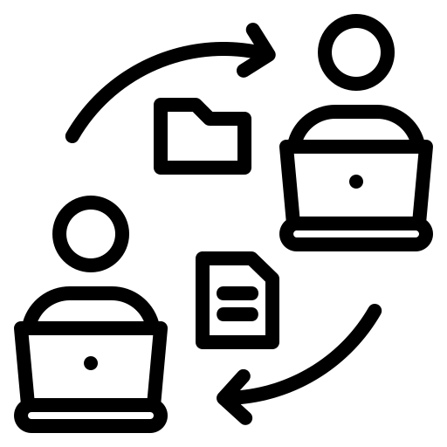



Pillar 5: Enhance cybersecurity through structured information-sharing frameworks
Under DORA’s fifth pillar on information-sharing, banks are guided to enhance cybersecurity resilience through structured exchanges of cyber threat intelligence with other financial entities. Following are the breakdown of the obligations a bank needs to fulfil to comply with this pillar:
Participation in Trusted Communities
Information-Sharing Arrangements
Documentation and Reporting
Guidelines for Involvement of Third Parties
Operational Resilience Goals
Banks are encouraged to share cyber threat information, including indicators of compromise, tactics, and cybersecurity alerts, within established and secure communities.
Example: set up communities composed of trusted financial entities aiming to collectively strengthen the sector’s cyber defense capabilities
Information-sharing must be done under arrangements that safeguard the confidentiality and sensitive nature of shared information. Any sharing of sensitive data must comply with the GDPR and respects anti-trust rules.
Example: create or refine information- sharing agreements and manage them in a centralised database
Banks must notify their participation in any information-sharing arrangements to relevant authorities. This notification includes their entry or exit from such arrangements and ensures transparency in their engagement with cybersecurity communities.
Example: understand reporting requirements and embed the reporting in relevant BAU processes
When sharing information, banks must delineate conditions for involvement of public authorities and ICT third-party providers. This provision include setting up IT platforms dedicated to secure data exchange.
Example: Participants must agree to share anonymized threat intelligence and refrain from using shared data for competitive purposes
The overarching objective of these arrangements is to improve the resilience of banks against cyber threats. By sharing threat intelligence, banks collectively strengthen defense mechanisms, mitigate cyber risks, and enhance response capabilities to incidents, thereby securing operational continuity.
Example: share best practices with peers to halt ransomware spread

Slide 12



Align compliance efforts with DORA’s phased implementation timeline
  ICT Third-Party Oversight Standards
  Regulatory technical standards specifying oversight for critical third-party ICT providers, including content and format requirements for information submissions, subcontracting disclosures, and team structures for oversight, are scheduled for submission by July 17, 2024
  Extended Review and Reporting
  By January 17, 2026, the European Commission is expected to review statutory auditor requirements and the potential inclusion of these entities under DORA's scope​
January 2024
July 2024
17 January 2025
January 2026
January 2028
  Drafting Regulatory Technical Standard
  The European Supervisory Authorities (ESAs) are set to submit initial regulatory technical standards for ICT risk management frameworks by January 17, 2024​
  Full Compliance Date
  Banks and other financial entities are expected to have operationalized all core components aligned with DORA’s standards, particularly regarding:
  ICT Risk Management Frameworks
  Third-Party Risk Oversight
  Incident Reporting
  Testing and Continuity Protocols
  Comprehensive Review
  A comprehensive review of DORA’s application and effectiveness is planned for January 17, 2028. This will assess the oversight framework’s impact on financial entities and explore potential updates to regulations​
  Reporting and Template Standard
  Templates for incident reporting, standards for ICT risk management processes, and documentation for ICT third-party service oversight are also due at this time
From January 2025 onwards, financial institutions must transition from implementation to sustained compliance and optimisation of their frameworks under the DORA. Activities in areas, among others, performing regular testing, monitoring and managing ICT third-party providers, and refining ICT risk management framework are required to be well-prepared for the comprehensive review in January 2028

Slide 13




Financial institutions face resource, expertise, and testing challenges under DORA
Smaller banks and growing fintech companies face unique challenges in meeting DORA’s stringent requirements. Limited resources, lack of specialized expertise, and minimal experience with established standards like ISO 27001 can make compliance particularly demanding.
Limited Resources and Expertise
Smaller institutions often lack dedicated ICT risk and compliance teams and expertise in area like penetration testing. Without these specialized resources, achieving compliance becomes both time-consuming and expensive. Also, coordinating between multiple teams (e.g., IT, security) is challenging, making harmonization between frameworks harder to accomplish
Financial Burden of Compliance
Meeting DORA's requirements requires significant investment in technology, tools, and skilled personnel. Smaller institutions may struggle with these costs, especially when outsourcing critical ICT functions
Complexity of Advanced Testing Requirements
TLPT and other advanced resilience assessments are new to many entities subject to DORA. Institutions without prior experience in advanced testing (e.g., ISO 27001 certification) face a steep learning curve in establishing compliant testing frameworks
Managing ICT Third-Party Risks
Many smaller banks and fintechs rely heavily on external ICT service providers but lack mature systems to manage these relationships effectively, exposing them to compliance failures under DORA. Strengthening these systems to be responsive adds operational complexity and demands additional resources
Overlapping Regulatory Obligations
Smaller institutions already comply with other EU directives which overlap with DORA in areas like incident reporting and cybersecurity. This creates confusion, duplicates efforts, and strains resources, making it harder to ensure full compliance
On the next slide, we explore how FiSer Consulting’s tailored services can help smaller banks and fintech companies address remaining gaps, enhance resilience, and meet ongoing DORA requirements beyond the January 2025 compliance milestone

Slide 14



Drive immediate compliance actions now and sustain efforts beyond January 17, 2025, for long-term DORA readiness
On 6 December 2024, the European Supervisory Authorities (ESAs) issued a statement addressing the challenges of DORA compliance. While supervisory guidance highlights critical actions, the ESA emphasizes no transitional period, requiring immediate compliance by 17 January 2025, as well as preparatory steps for key developments in the second half of 2025.
Immediate Application from
17 Jan 2025
DORA will apply without a transition period, and entities must align with the technical standards and guidelines issued in January and July 2024
Need for
Structured Gap Analysis
Entities are expected to identify and address gaps between their setups and DORA requirements, building on sectoral guidelines
New Reporting Obligations in
Early 2025
Banks must prepare ICT third-party registers for submission by 30 April 2025 and ensure incident reporting readiness from the application date
Critical Third-Party ICT Provider Designation (H2 2025)
ICT third-party providers meeting criticality criteria must assess their operational setups against DORA
Risk-Based Supervision by Authorities
Supervision will account for the risk profile, size, and complexity of financial entities, focusing on cyber and digital resilience
Banks must accelerate preparations to ensure readiness for full compliance from day one
Conduct a structured review of internal systems to prioritize areas of non-compliance
Leverage lessons from the 2024 ESA dry-run exercise and adopt the ITS on Register of Information
Early engagement with key ICT providers to ensure alignment and mitigate risks
Prepare for a pragmatic and outcomes-focused implementation approach by aligning internal policies with supervisory priorities
The ESA’s guidance underscores the urgency of conducting gap analyses, preparing for new reporting obligations, and managing third-party risks, emphasizing that compliance efforts must continue beyond January 17, 2025, with critical milestones like reporting and third-party designations still ahead

Slide 15
Implement scalable and phased approaches to meet DORA compliance efficiently
Focused Training Programs
Equip staff with DORA-specific skills through targeted training and collaboration with regulators.
Example: Access subsidized training programs offered by regulatory bodies
Phased Implementation
Prioritize high-risk areas first to distribute compliance costs over time.
Example: Start with implementing incident reporting frameworks to meet immediate deadlines
Timely
Reporting
Align testing with existing standards like ISO 27001 or NIST CSF to simplify processes.
Example: Incorporate ISO 27001 risk assessments into testing protocols
Standardized Testing Framework
Use platforms to track contracts, performance, and compliance for third-party providers.
Example: Monitor service-level agreements and audit reports with GRC tools
Regulatory Harmonization
Advocate for aligning DORA requirements with existing frameworks to reduce overlap
Example: Collaborate with industry groups to submit joint feedback to regulators
SOLUTIONS
Challenges
Limited Resources and Expertise
Financial Burden of Compliance
Complexity of Advanced Testing Requirements
Managing ICT Third-Party Risks
Overlapping Regulatory Obligations

Slide 16





FiSer Consulting offers tailored services to your organization and ensure a smooth transition
FiSer Consulting is a young, niche, and independent consulting firm focused on international business transformation within Financial Services. With broad project management experience across large Dutch banks, international insurers, and smaller clients, we bring expertise in regulatory implementation across various disciplines. Rather than focusing solely on IT solutions, we offer a helicopter view of DORA compliance, tailoring project governance and roadmaps to meet your needs after the 17 January 2025 compliance deadline.
Advanced Compliance & Testing
Conduct comprehensive testing of ICT continuity by simulating potential failures of ICT providers. Implement metrics to track ICT risk incidents, reporting data to align with expected updates in 2026 for statutory auditors and expanded oversight criteria
Implementation Roadmap
Design a roadmap with clear steps, timelines, resource requirements, and controls to achieve compliance on regulatory reporting
Ongoing Advice and Stakeholder Engagement
Provide continuous consultation to navigate complexities of governance and data management, ensuring successful delivery. Foster ongoing steering with all stakeholders, facilitating alignment with reporting requirements to obtain assurance
Gap Analysis
Assess the program’s effectiveness and identify gaps in early 2026 based on ESA feedback and performance metrics from simulated incident responses
Alignment with New Proposals
Prepare for updates following the 2028 review, anticipating potential enhancements to third-party oversight and ICT risk management requirements. Reinforce training programs, adapting to any new regulatory standards or amendments resulting from DORA’s comprehensive review in 2028
Notes:
Phase 1: Preparation and Initial Compliance (By January 2024)
Establish ICT Risk Management Framework: Set up policies and processes for risk management, incident detection, and response as per initial technical standards.
Incident Reporting: Develop templates and training for timely incident reporting following DORA's outlined reporting structure.
Stakeholder Training: Conduct mandatory training sessions for all relevant personnel to align operational procedures with new DORA requirements.
Phase 2: Third-Party Management and Oversight (January - July 2024)
ICT Third-Party Oversight: Implement protocols for overseeing critical third-party ICT providers. This includes contractual alignment with DORA’s provisions and integrating oversight data submissions as per the upcoming July 2024 standards.
Enhanced Incident Response: Revise incident response strategies to incorporate structured escalation protocols and early warning systems based on the forthcoming technical standards.
Coordination with ESAs: Establish regular reporting and monitoring processes to facilitate compliance with ESAs’ guidance on third-party oversight.
Phase 3: Advanced Compliance & Testing (July 2024 - January 2026)
Annual Risk Assessments and Testing: Conduct comprehensive testing of ICT continuity and response plans, simulating potential failures of ICT providers to ensure preparedness and identify areas for improvement.
Enhanced Reporting and Metrics: Implement metrics to track ICT risk incidents, reporting data to align with expected updates in 2026 for statutory auditors and expanded oversight criteria.
Stakeholder Feedback Loops: Regularly update management on compliance progress, incident response metrics, and emerging regulatory insights from ESA and the European Commission.
Phase 4: Long-Term Compliance and Program Review (2026 - 2028)
Program Evaluation: Assess the program’s effectiveness in early 2026 based on ESA feedback and performance metrics from simulated incident responses.
Alignment with New Proposals: Prepare for updates following the 2028 review, anticipating potential enhancements to third-party oversight and ICT risk management requirements.
Ongoing Compliance Training: Reinforce training programs, adapting to any new regulatory standards or amendments resulting from DORA’s comprehensive review in 2028.

Slide 17




Connect with FiSer Consulting for expert guidance on DORA compliance
FiSer has a proven track record in helping clients navigate complex regulatory implementations. Hence, we offer tailored services to meet the needs of your business, ensuring a smooth and efficient path to achieve compliance.
Dirk Worm – Managing Partner
Dirk has nearly 30 years of experience in the financial services industry, particularly in the fields of Treasury & Financial Markets and Risk & Finance, specializing in program management and advisory.
Pei-Hsuan Lo – Senior Consultant
Pei-Hsuan has eight years of experience in banking, working in strategic transformation programmes across Risk Management and Retail Banking, combining regulatory and business elements.
d.worm@fiser.consulting
pei-hsuan.lo@fiser.consulting
Camila Herrera – Senior Consultant
Camila is a banking professional with a background in Asset & Liability Management, Funding Strategy, and Debt Capital Markets. Certified as a Project Management Professional (PMP®), she has a track record of leading cross-functional projects and directing strategic change initiatives.
Gabor Lorincz – Consultant
Gabor is a consultant focusing on risk advisory services for banks. With proficiency in model development and validation, he helps clients to achieve successful transformations based on new regulations, digital transformation, changing customer demands and business model disruptions.
c.herrera@fiser.consulting
g.lorincz@fiser.consulting
FiSer Consulting Website
info@fiser.consulting
Follow us on LinkedIn!
17

Slide 18

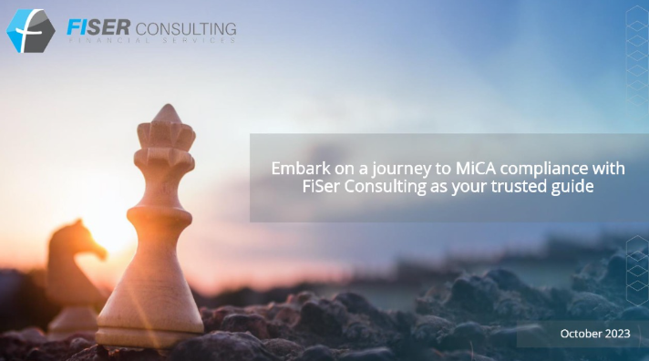

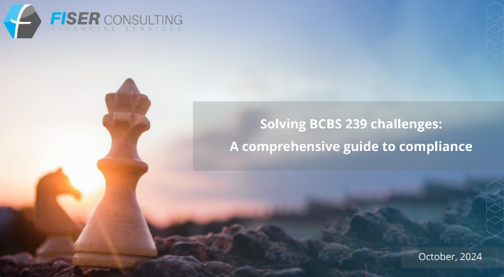
Explore FiSer’s expertise and publications for deeper insights into DORA compliance
Nurturing an intense knowledge-sharing culture by continuously publishing positioning papers and niche media:
See all our publications: FiSer Consulting – Publications – Assurance for Delivery
EU Artificial Intelligence Act
MiCA Compliance
Regulatory Roadmap for EU Banks
BCBS 239 Challenges

