Slide 1
Why it is challenging for banks to remediate data in credit risk model development
August 2023

Slide 2
Table of Contents
1
Executive Summary
2
Credit Risk Models are at the heart of any Bank’s Model Landscape
3
Quality data ensures successful model (re-)development
4
Customer Demands and Regulatory Requirement Are The Main Drivers Of Historical Data Remediation
5
The EU demands banks to remediate data for their IRB models
6
Fiser’s recommendations

Slide 3

Executive Summary
Need to elaborate and ensure it becomes an executive summary
Credit risk models represent mathematical frameworks employed by financial institutions, particularly banks, to gauge the level of credit risk linked to their lending and investment portfolios. This form of risk pertains to the potential scenario wherein borrowers fail to meet their obligations, thereby causing financial losses for the banks. As a result, these models evaluate various aspects such as the creditworthiness of borrowers, the likelihood of default, the extent of loss in case of default, and other pertinent risk factors.
To achieve high-performance models, in particular those built by the IRB (Internal Ratings-Based) approach, ensuring the quality of the dataset is of utmost importance. Nevertheless, the task of creating and maintaining such a comprehensive dataset poses significant challenges. The global financial crisis of 2008 brought to light a notable issue, wherein many banks lacked the capability to swiftly and accurately aggregate risk-related data across various business lines and legal entities.
In response, the Financial Stability Board (FSB) introduced the Policies, Exceptions, Reports, Data Aggregation, and Risk Reporting (PERDARR), also recognized as the BCBS 239 principles, in 2013 to guide financial institutions in establishing a sound risk data and reporting capabilities.
Our analysis has revealed that historical data remediation is primarily driven by customer demands and regulatory mandates. The landscape of information technology within financial establishments undergoes constant changes due to the modernization of legacy systems, shifts in customer journeys, and the evolution of regulatory obligations. Concurrently, over the past decade, the European Central Bank (ECB) has initiated several undertakings, such as the TRIM and SREP investigations, which necessitate robust data capabilities from the entities under its supervision. The escalating regulatory requirements result in substantial workloads across the entire risk management chain within the organization. To manage such substantial and intricate transformations effectively, we propose that financial institutions establish a Project Management Office (PMO) to facilitate interdisciplinary communication.
…

Slide 4




Credit Risk Models are at the heart of any Bank’s Model Landscape
Remove duplicate information from slide 4/5
Credit risk models are mathematical frameworks used by banks to estimate the credit risk associated with their lending and investment portfolios. Credit risk is the type of risk that borrowers default on their obligations, leading to losses for banks. Hence, these models assess borrowers' creditworthiness, probability of default, loss given default, and other risk parameters.
Lending
Decision process
Modelling Approaches
Use in Europe
Complexity
Lending is at the core of banking. Borrowers’ ability to pay, the economic outlook, the value of collaterals, etc. are the considerations leading to the final decision on limits.
Borrowers’ liquidity and industry cyclicality determine their ability to pay, location and interest rate lead to the current value of collaterals. Hence banks develop credit risk models.
Three credit risk modelling approaches – Standardize (STA), F-IRB, and A-IRB – are allowed when a bank is calculating its own funds.
A-IRB is applied by banks in north-west Europe in particular, for it leads to the least capital reserve among all the approaches
To make A-IRB models successful, quality controls on dataset are essential because data with sufficient granularity enable high performance models.

Slide 5



Quality data ensures successful model (re-)development
https://www.bis.org/publ/bcbs239.pdf
Reduce the amount of text regarding PEDDAR
Add more practical points: what’s the value for banks to adhere to PEDDAR
Why PERDARR was introduced?
The 2008 global financial crisis exposed that many banks lacked the ability to aggregate risk data quickly and accurately across business lines and between legal entities.
As a result, the Policies, Exceptions, Reports, Data Aggregation, and Risk Reporting (PERDARR), also known as the BCBS 239 principles, was introduced by the Financial Stability Board (FSB) in 2013 to address the weaknesses in risk data aggregation and reporting of financial institutions.
What is PERDARR about?
The PERDARR covers key areas governance and infrastructure, risk data aggregation capabilities, risk reporting practices, and supervisory review to prompt banks establish sound risk data aggregation capabilities and produce accurate and timely risk reports.
The principles took effect in January 2016 for globally systemically important banks (G-SIBs) and three years after designation for other significant banks (O-SIBs). Nowadays, many banks worldwide have adopted these principles as best practices in their own data quality control framework.
What value banks can create by adopting PERDARR?
Banks can create a comprehensive framework around their risk data aggregation and reporting practices by adhering to the guidelines of PERDARR. The benefits are translated as
  High-quality decision-making on lending and the overarching risk strategy
  More accurate risk assessments, potentially resulting in lower capital requirements
  More effective cross-functional alignment and improved operational efficiency
Notes:
19. All the Principles included in this paper are also applicable to processes that have been outsourced to third parties. 20. The Principles cover four closely related topics: • Overarching governance and infrastructure • Risk data aggregation capabilities • Risk reporting practices • Supervisory review, tools and cooperation
33. A bank should establish integrated16 data taxonomies and architecture across the banking group, which includes information on the characteristics of the data (metadata), as well as use of single identifiers and/or unified naming conventions for data including legal entities, counterparties, customers and accounts.
Better data - > better prediction -> more revenue
Better data -> better decision + automation -> reduce operational cost/ risk

Slide 6
Customer Demands and Regulatory Requirement are The Main Drivers Of Historical Data Remediation
There are multiple scenario that can cause a large scale of data remediation exercise.
Legacy System
01
Legacy systems were usually built on outdated data formats, databases, or data storage methods, which are no longer compatible with modern systems or industry standards.
Over time, legacy systems may have accumulated redundant and duplicate data, which can lead to data integrity issues and complicate data management and analysis efforts.
Older systems might not have robust data governance practices in place, such as data quality control, data lineage, or data retention policies. This lack of data governance can lead to data inaccuracies, inconsistencies, and potential compliance issues.
Changes in Customers’ Journey
02
From customer take-in to exiting, banks acquire and store tremendous amount of data that are fundamental to build effective credit risk models.
Customers labelled high-risk in the business line A can be risk-free in the business line B. Data is nuanced in meanings within the organisation that a common data language is significantly lack of.
Evolution in Regulatory Requirements
03
To harmonise the definition of default across the EU prudential framework and improve consistency, European Central Bank (ECB) announced the standardised definition of default in 2016.
Definition of a dataset could change as time pass due to shifts of regulatory requirements or corporate strategy selection, leading to a discrepancy where remedial activities need to be carried out.

Slide 7



The EU demands banks to remediate data for their IRB models
In the latest decade, the European Central Bank (ECB) has launched several initiatives to request a strong data capabilities from its supervised entities. From meticulous data governance to crafting comprehensive reports, the supervised entities are expected have significant number of workloads to be fully compliant to the increasing regulatory requirements around risk data and the corresponding reporting. This requires a close collaboration of various functions, among others, policy, business, modelling and IT implementation. Setting up a PMO office helps facilitate the communication and hence ensure the success of this complex transformation.
TRIM Mission was launched in 2016
SREP targets five supervisory priorities
Guide on RDARR to gather good industry practices
In 2016, the ECB launched the Targeted Review of Internal Models (TRIM) to ensure homogeneity among internal models used to calculate RWA.
During the TRIM investigation, the ECB carried out a thorough data quality review. Areas for instance data quality monitoring and internal controls, and roles and responsibilities allocation in data management required further improvement. Findings were issued, demanding banks to remediate data used in their current IRB models.
In 2016, the ECB announced that business model and profitability risk, credit risk, capital adequacy, risk governance and data quality, and liquidity are the top five supervisory priorities of the year, which materialised in Supervisory Review and Evaluation Process (SREP) investigation.
The institution’s risk infrastructure, data aggregation and reporting is considered a main aspects in risk governance. While quality data sustain accurate demonstration of capital adequacy and liquidity adequacy.
In July 2023, the ECB has opened a public consultation on its guide for effective risk data aggregation and risk reporting (RDARR).
This guide is intended to assist banks improving their capabilities in RDARR by following good industry practices and adhering to the Basel Committee on Banking Supervision’s Principles (BCBS 239).
…

Slide 8





Overcoming implementation challenges: Strategies for a smooth transition to new data landscape
FiSer Consulting is a young, niche and independent consulting firm with an exclusive focus on international business transformation within Financial Services. Our people have a broad range of experience with all large Dutch banks, multiple international insurers and smaller clients. For all of these clients FiSer has helped to examine the data and modelling landscape.
Target Landscape
Prepare your vision on the data for the modelling landscape.
Develop a strategic roadmap
Create a roadmap including necessary steps, timelines, and resources required.
Always Expert Advice
Continually consult with advisors to navigate the complexities and ensure a successful delivery.
Gap Analysis
Conduct a thorough gap analysis to identify areas where your business needs to enhance.
Engage Stakeholders
Engage all stakeholders, including senior management, employees, and third-party service providers.

Slide 9



FiSer Consulting Contact our colleagues for further assistance
FiSer has a proven track record in helping clients navigate complex regulatory changes. Hence, we offer tailored services to meet the needs of your business, ensuring a smooth and efficient path to data compliant in credit risk modelling.
Jeroen Wiggers - Banking Lead
Jeroen is a banking professional with more than ten years of experience. He worked on large-scale regulatory and transformation projects. He has performed several regulatory gap assessments at banks.
Robin De Vries - Senior Consultant
Robin has over five years’ experience in Management Consulting, with international experience with large transformation projects with banks and insurers.
Pei Hsuan Lo – Consultant
Pei-Hsuan has over seven years of experience on banking, working strategic transformation programmes across Risk Management and Retail Banking.
j.wiggers@fiser.consulting
r.devries@fiser.consulting
9
Pei-Hsuan.Lo@fiser.consulting
FiSer Consulting Website
info@fiser.consulting
Follow us on Linkedin!
Notes:
Robin

Slide 10
For references

Slide 11
RWA calculation framework issued by Basel Accord helps banks manage their credit risk in a unified structure
Try to reduce the amount of text
- Intro of Credit Risk
RWA
Credit risk models
Modelling approaches
Basel IV
To help banks control credit risk in a unified manner, the Basel Accord issued the minimum capital requirement for banks to hold against adverse risk events. The minimum capital requirement is calculated based on the Risk-Weighted Assets (RWA), where assets with higher credit risk are assigned with the higher weight.
01
The outputs of credit risk models, such as credit ratings or probabilities of default, are used to determine the appropriate risk weights for each asset class.
02
In most cases, banks using Internal Ratings-based (IRB) Approach to calculate RWA make smaller capital requirements than those determined by the STA. Hence, banks are more willing to take this approach.
03
How do banks measure credit risk? Credit risk models is the key. Credit risk models are mathematical frameworks used by banks to estimate the credit risk associated with their lending and investment portfolios. These models assess borrowers' creditworthiness, probability of default, loss given default, and other risk parameters. The outputs of credit risk models, such as credit ratings or probabilities of default, are used to determine the appropriate risk weights for each asset class.
Under Basel II, banks who meet certain conditions, disclosure requirements and approval from the competent authority, can use their own risk parameters to calculate RWA to estimate capital for various exposures. This approach refers to Internal Ratings-based (IRB) Approach. The IRB Approach usually leads to smaller capital requirements than those determined by the Standardised Approach (STA), where banks are requested to use risk weights provided by the regulator to quantify required capital. Hence, banks are more willing to take this approach. Under the umbrella of the IRB Approach, there are two sub-approaches:
FIRB, the Foundation Internal Rating-Based Approach, allows banks to develop their own empirical model to estimate the PD for individual clients or group of clients, while banks should use the LGD and the EAD prescribed by the regulator.
AIRB, the so-called Advanced Internal Rating-Based Approach, allows banks to estimate risk parameters - PD, LGD, and EAD - themselves and hence determine the amount of capital requirements. The only condition is that computations respect some minimum guidelines, which are set by the regulator. By adopting AIRB, banks with profound risk management control usually need less capital requirements. On the contrast, adopting AIRB means tremendous data inputs, so in most of the cases only big banks can afford employing this method .
On the other hands, The new framework Basel IV, which was made to harmonise banks’ calculations of their RWA, will take effect in multiple phases from 2021 to 2025. In Basel IV, an output floor of the internal model use is set at 72.5%, meaning banks are allowed to reduce their own funds aggregately by 27.5%. The new reforms also modify the leverage ratio, the credit valuation adjustment, and the operational risk frameworks. This big wave of regulatory change is expected to drive another large scale of data remediation in the coming years, further prioritising data related issues on banks’ to-do list.

Slide 12
The EU demands banks to remediate data for their IRB models
to visualise
More sales driven: supervisor is paying increasing attention on data quality and reporting -> more works are expected -> Fiser can help
Since the latest decade, the European Central Bank (ECB) has launched several initiatives to request a strong data capabilities from its supervised entities.
Same in 2016, ECB launched the Targeted Review of Internal Models (TRIM) to ensure homogeneity among internal models used to calculate RWA. The project aimed to review the models that significantly impact the RWA calculation. After almost two years of preparation, the ECB conducted a series of on-site inspections at the significant institutions (SIs) and issued over 5.800 findings across three risk types - credit risks, market risks, and counterparty risks. Some findings are not necessarily violating the regulations - they are issued because the regulations were not clear in the past, the IT capabilities was not sufficient to fulfil the data requirements imposed later, or as simple as the definition of a certain regulatory standard has changed. However, these findings demand banks to remediate data used in their current IRB models.
During the TRIM investigation, the ECB carried out a thorough data quality review. It showed that banks were doing well in implementing data management initiatives, for example for those requested by the Basel Accord. However, there are still rooms for improvement in areas such as data quality monitoring and internal controls, and roles and responsibilities allocation in data management. Compliance in data management and the urgency to put more resources in data quality and controlling processes has increasingly been ECB’s focus. In 2016, the ECB announced that business model and profitability risk, credit risk, capital adequacy, risk governance and data quality, and liquidity are the top five supervisory priorities of the year, which materialised in Supervisory Review and Evaluation Process (SREP) investigation. Banks that performed poorly may face increased regulatory capital requirements and more scrutiny.
Furthermore, the ECB has implemented a standardized definition of default for banks and other supervised entities within the eurozone. This standardized definition was introduced as part of the Single Rulebook, which aims to harmonize regulations and supervisory practices across the European Union (EU) member states. Based on the guidelines provided by the European Banking Authority (EBA), the Definition of Default, or DoD, sets a common and consistent threshold for identifying when a borrower or debtor is considered in default on their credit obligations. To fully implemented the new DoD, the supervised entities subsequently launched a large scale of data remediation plan – actions taken to boost data consistency, accuracy and integration; reviews on historical data; establishments on data governance and reporting; investment in technology and infrastructure.
In July 2023, the European Central Bank (ECB) has opened a public consultation on its guide for effective risk data aggregation and risk reporting (RDARR). This guide is intended to assist banks in improving their capabilities in RDARR by following good industry practices and adhering to the Basel Committee on Banking Supervision’s Principles (BCBS 239). It is part of a broader strategy to address identified structural shortcomings in risk data aggregation at supervised banks. Interested parties can submit comments using the provided template until midnight CET on October 6, 2023, and a stakeholder meeting will be held on September 15, 2023. Further details on the consultation process, including how to submit questions and comments, can be found in the original announcement.

Slide 13
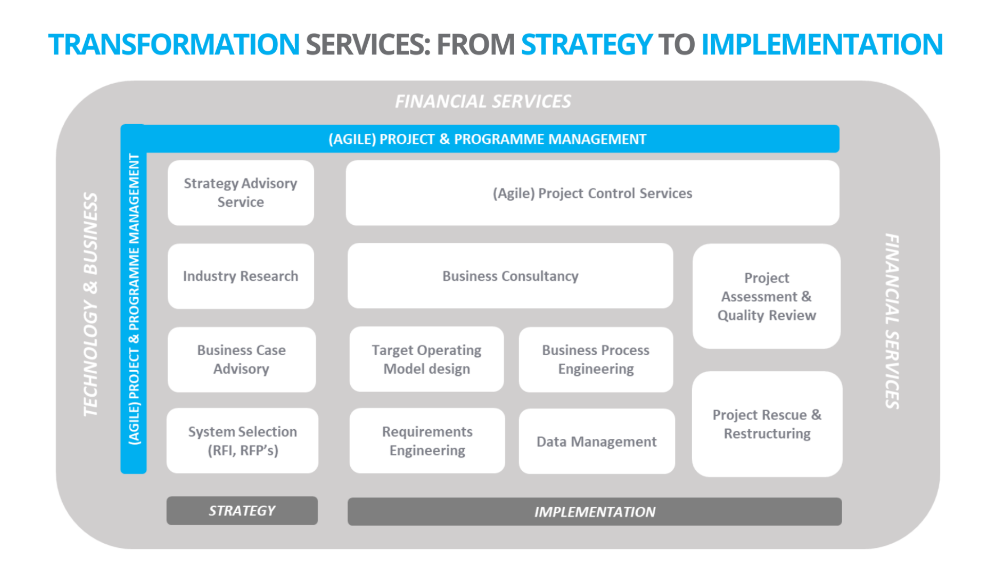
Overcoming implementation challenges: Strategies for a smooth transition to new data landscape
Ready for review
Our Proposed Approach
FiSer Consulting is a young, niche and independent consulting firm with an exclusive focus on international business transformation within Financial Services. Our people have a broad range of experience with all large Dutch banks, multiple international insurers and smaller clients. For all of these clients FiSer has helped to examine the data and modelling landscape.
Target Landscape
Gap Analysis
Develop a roadmap
Always Expert Advice
Engage Stakeholders
Prepare your vision on the data for the modelling landscape
Conduct a thorough gap analysis to identify areas where your business needs to enhance
Create a roadmap including necessary steps, timelines, and resources required.
Engage all stakeholders, including senior management, employees, and third-party service providers.
Continually consult with professional advisors to navigate complexities and ensure a successful road to your new target landscape.
Notes:
Robin

